Slide 1
GIT VERSION CONTROL SYSTEM BY USING AMAZON WEB SERVICES
-- VEERA REDDY INAKOLLU

Slide 2
CONTENTS :
CREATING EC2 INSTANCE
CREATING REPOSITORY IN LOCAL MACHINE
CREATING REPOSITORY IN REMOTE LOCATION
WORKING WITH REMOTE REPOSITORY
PUSHING LOCALLY CREATED REPO IN GITHUB
CREATING NEW BRANCH FROM MAIN BRANCHE
PULL ALL BRANCHS IN YOUR LOCAL MACHINE
MERGE OUR FEATURE BRANCH WITH MAIN BRANCH
GO TO LOCAL MACHINE

Slide 3
GIT:
Git plays a crucial role in DevOps by enabling version control and collaboration across teams
SOME KEY FEATURES:
Version Control: Git tracks changes in files, enabling versioning of code, configuration, and other assets. It helps developers keep track of changes over time and revert to previous versions when necessary.
Branching and Merging: Git allows for easy creation of branches, enabling teams to work on different features or bug fixes simultaneously without affecting the main codebase. Branches can be merged back into the main branch once development is complete.
Commit History: Git maintains a detailed history of all changes made, with each commit being accompanied by a message describing the change. This makes it easy to track down specific changes and understand why they were made.
Integration with CI/CD: Git integrates seamlessly with Continuous Integration/Continuous Deployment (CI/CD) tools like Jenkins, GitLab CI, and others, allowing automated testing, building, and deployment of applications whenever new code is pushed to the repository.

Slide 4
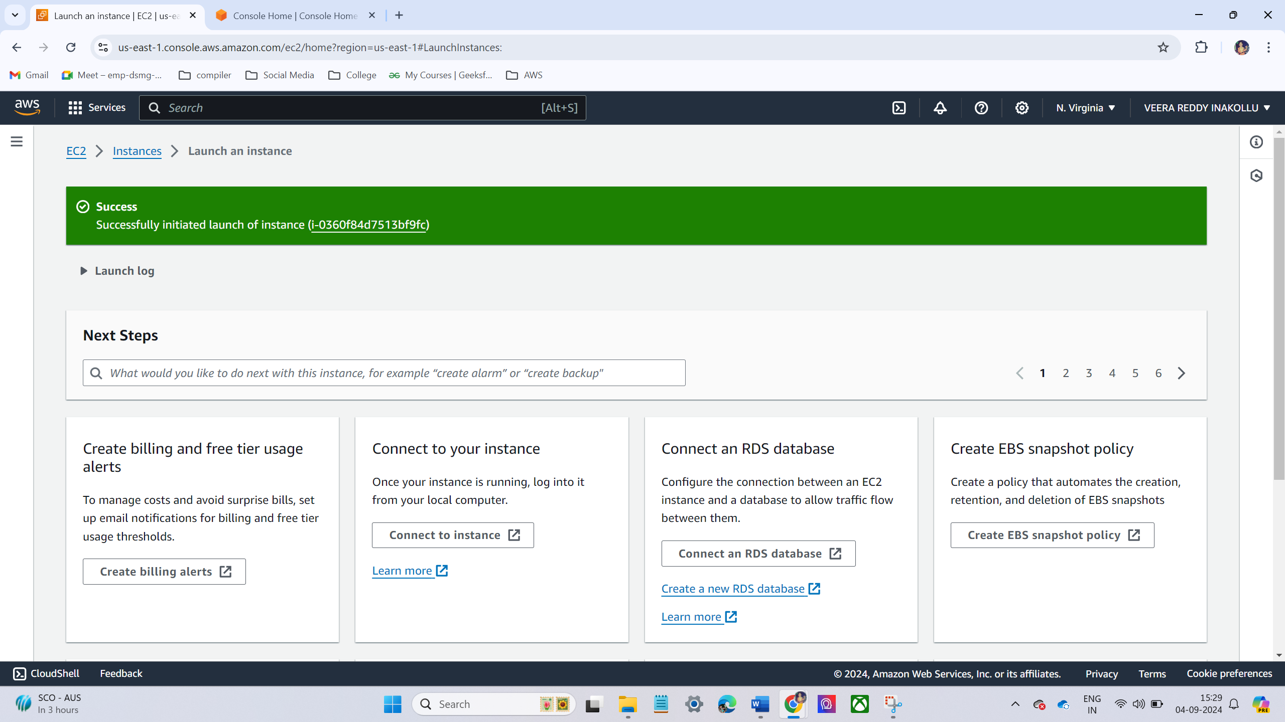
LAB -1 - CREATING EC2 INSTANCE:
Login into aws console.
Go to EC2 console →choose Launch instance.
Choose Amazon Linux operating system
Instance type = t2. Micro
Choose existing key pair
Allow inbound rules
Instance launch successfully

Slide 5
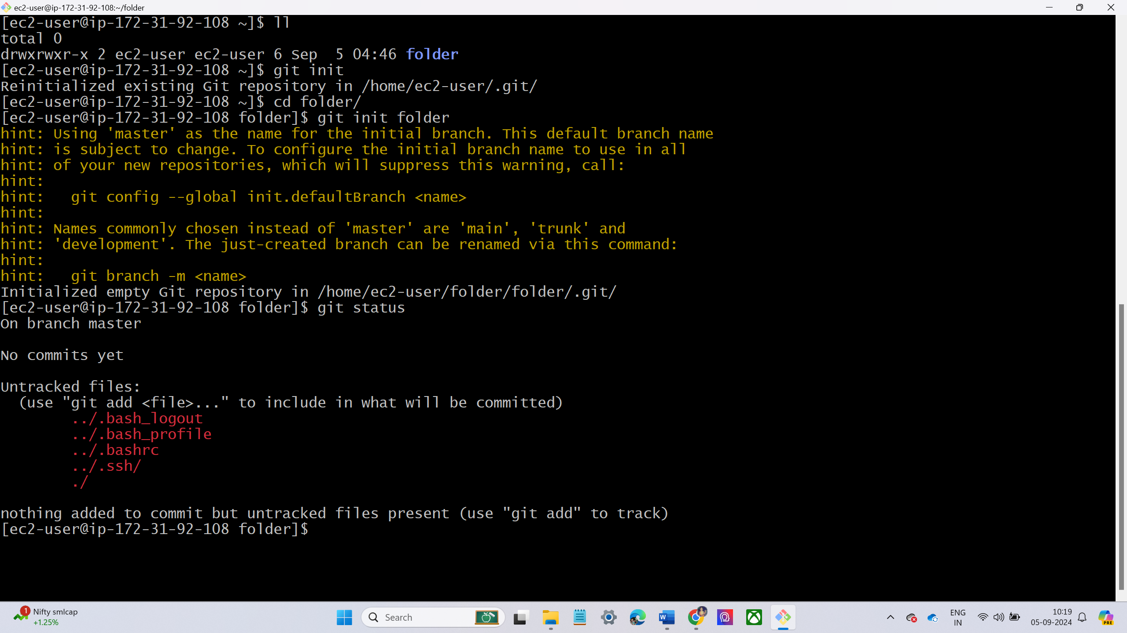
LAB -2 – CREATE REPOSITORY IN LOCAL MACHINE.
First, we have created a directory n local machine using touch command.
Move to that folder and initialize the folder using git init command
Check the status

Slide 6

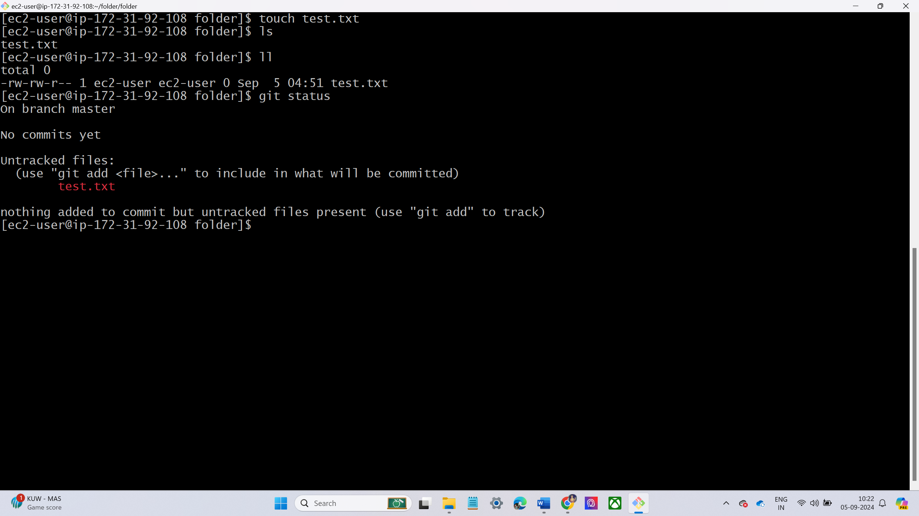
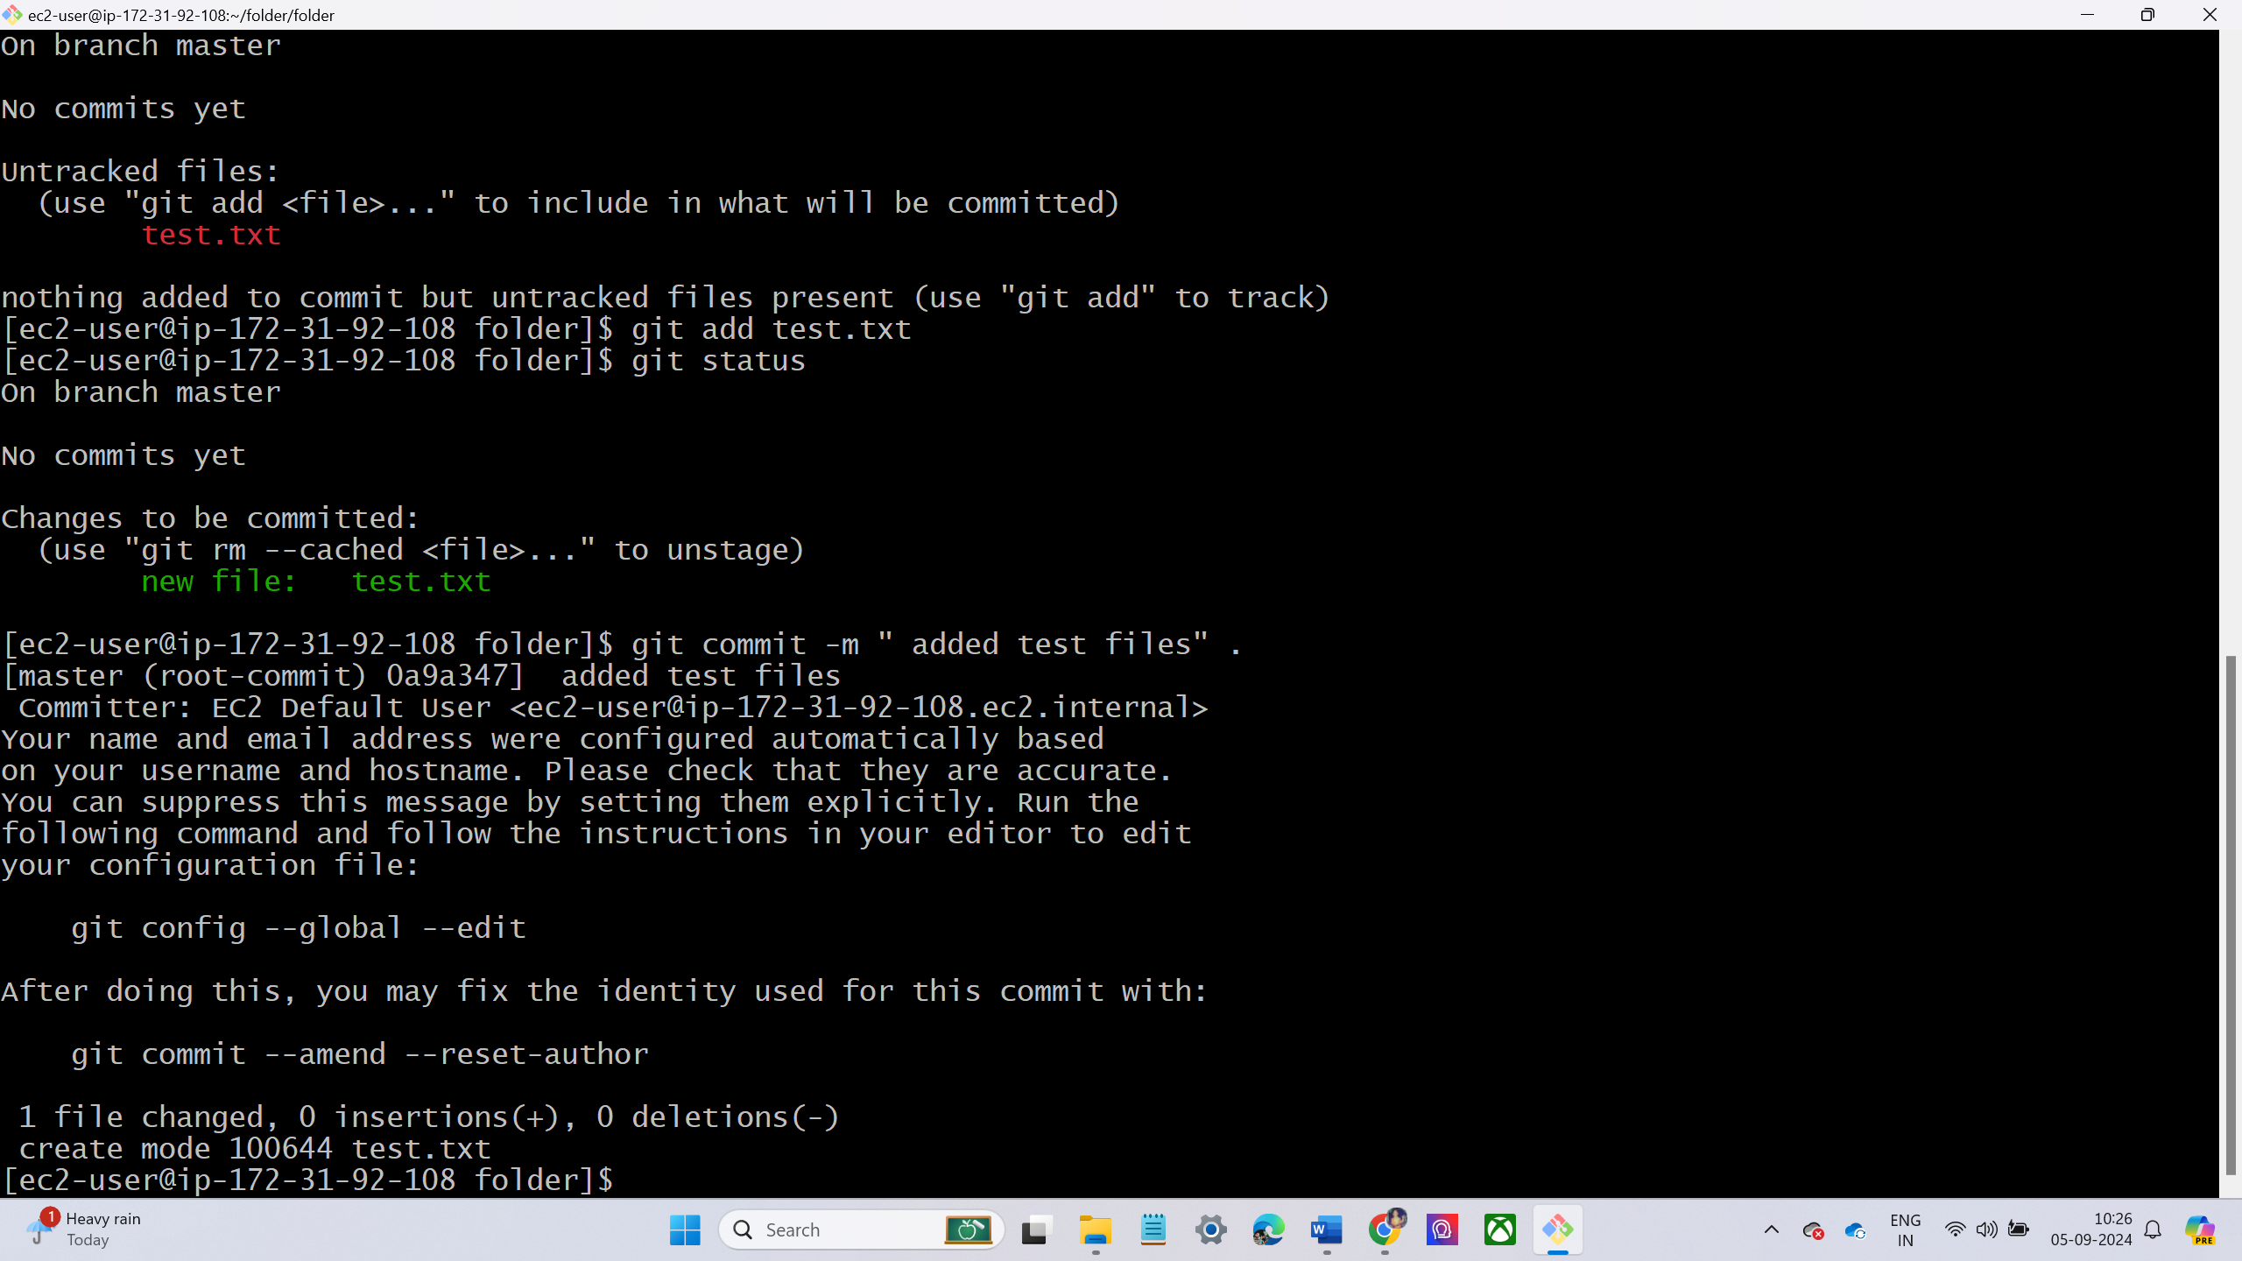
Now create some files using touch command
Now the files are in working directory then move to staging area using git add command
Now the files are moved to working to local repo using git commit command
Again check status.

Slide 7
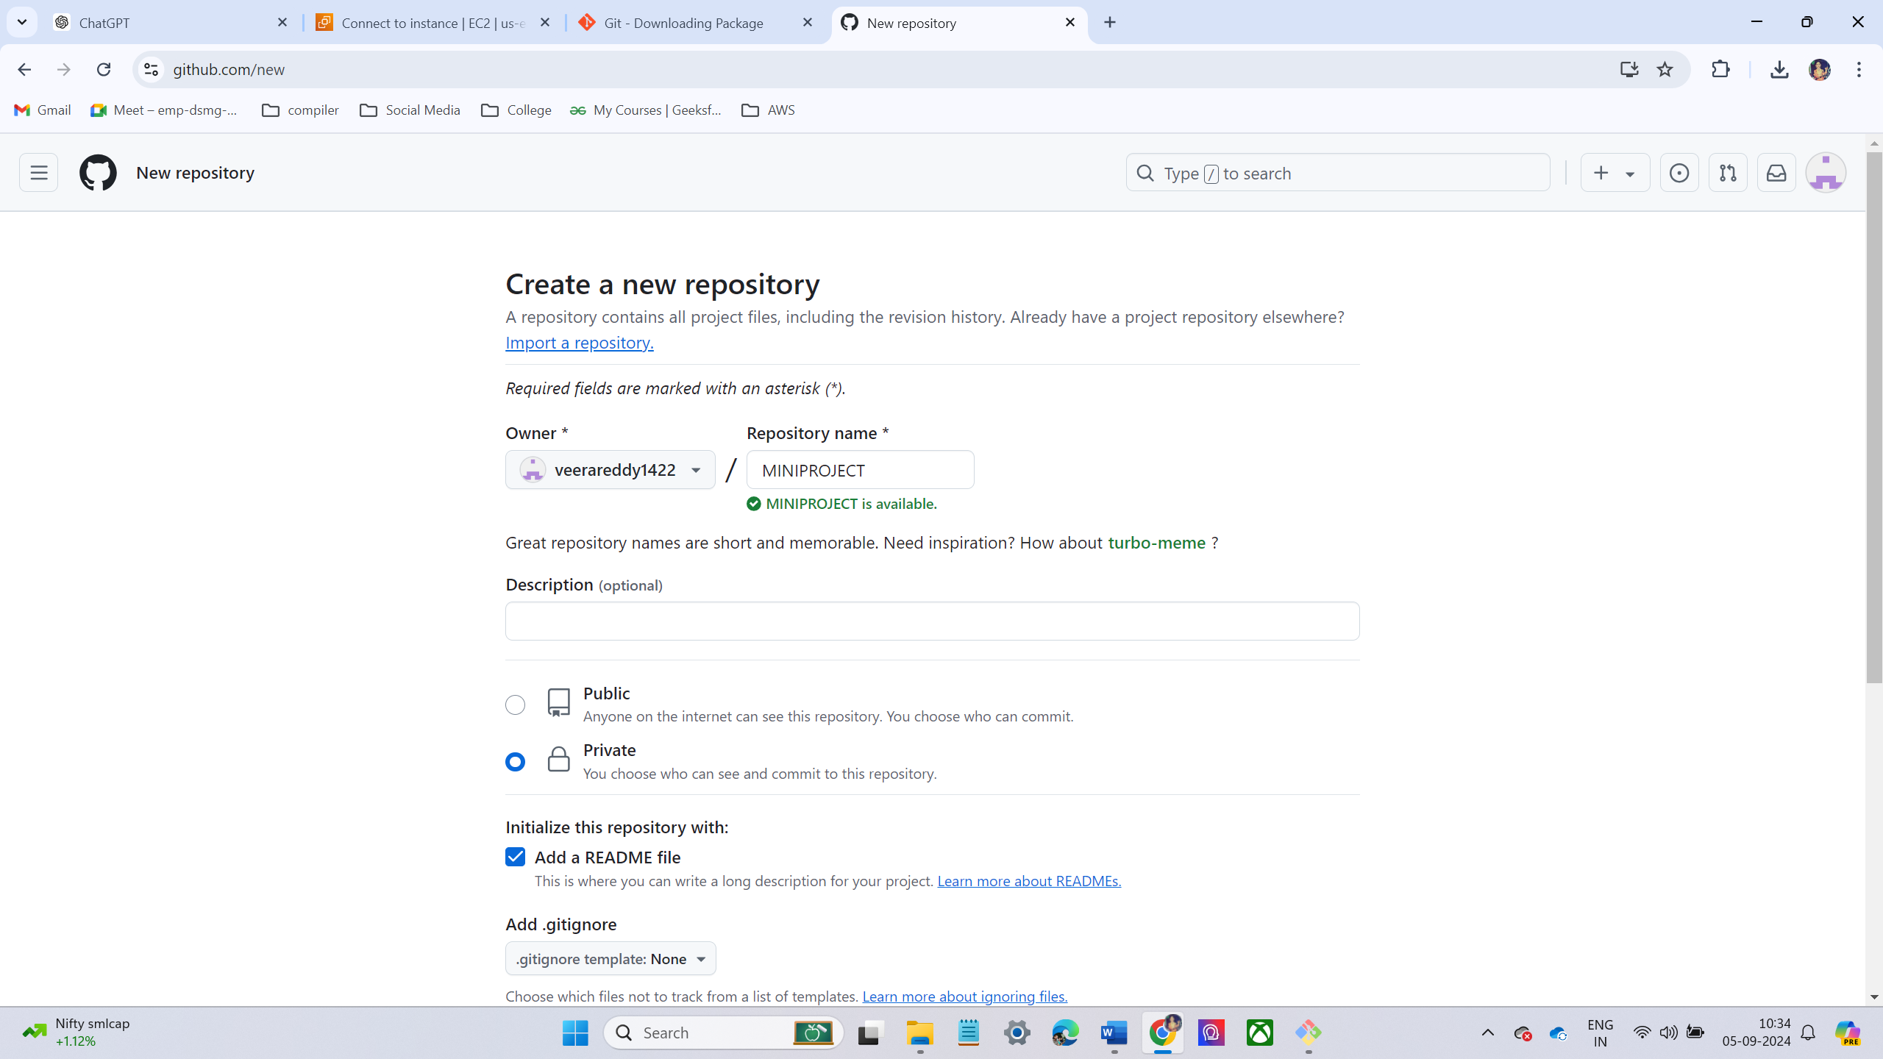
LAB -3 – CREATING REPOSITORY IN REMOTE LOCATION – GITHUB
Open GitHub login with credentials
On GitHub dashboard, click on the green "New" button located on the upper-right side.
Fill in the Repository Details
Provide a repository name: Enter a unique name
Choose visibility: Private
Initialize with a README.md file
Create the Repository

Slide 8
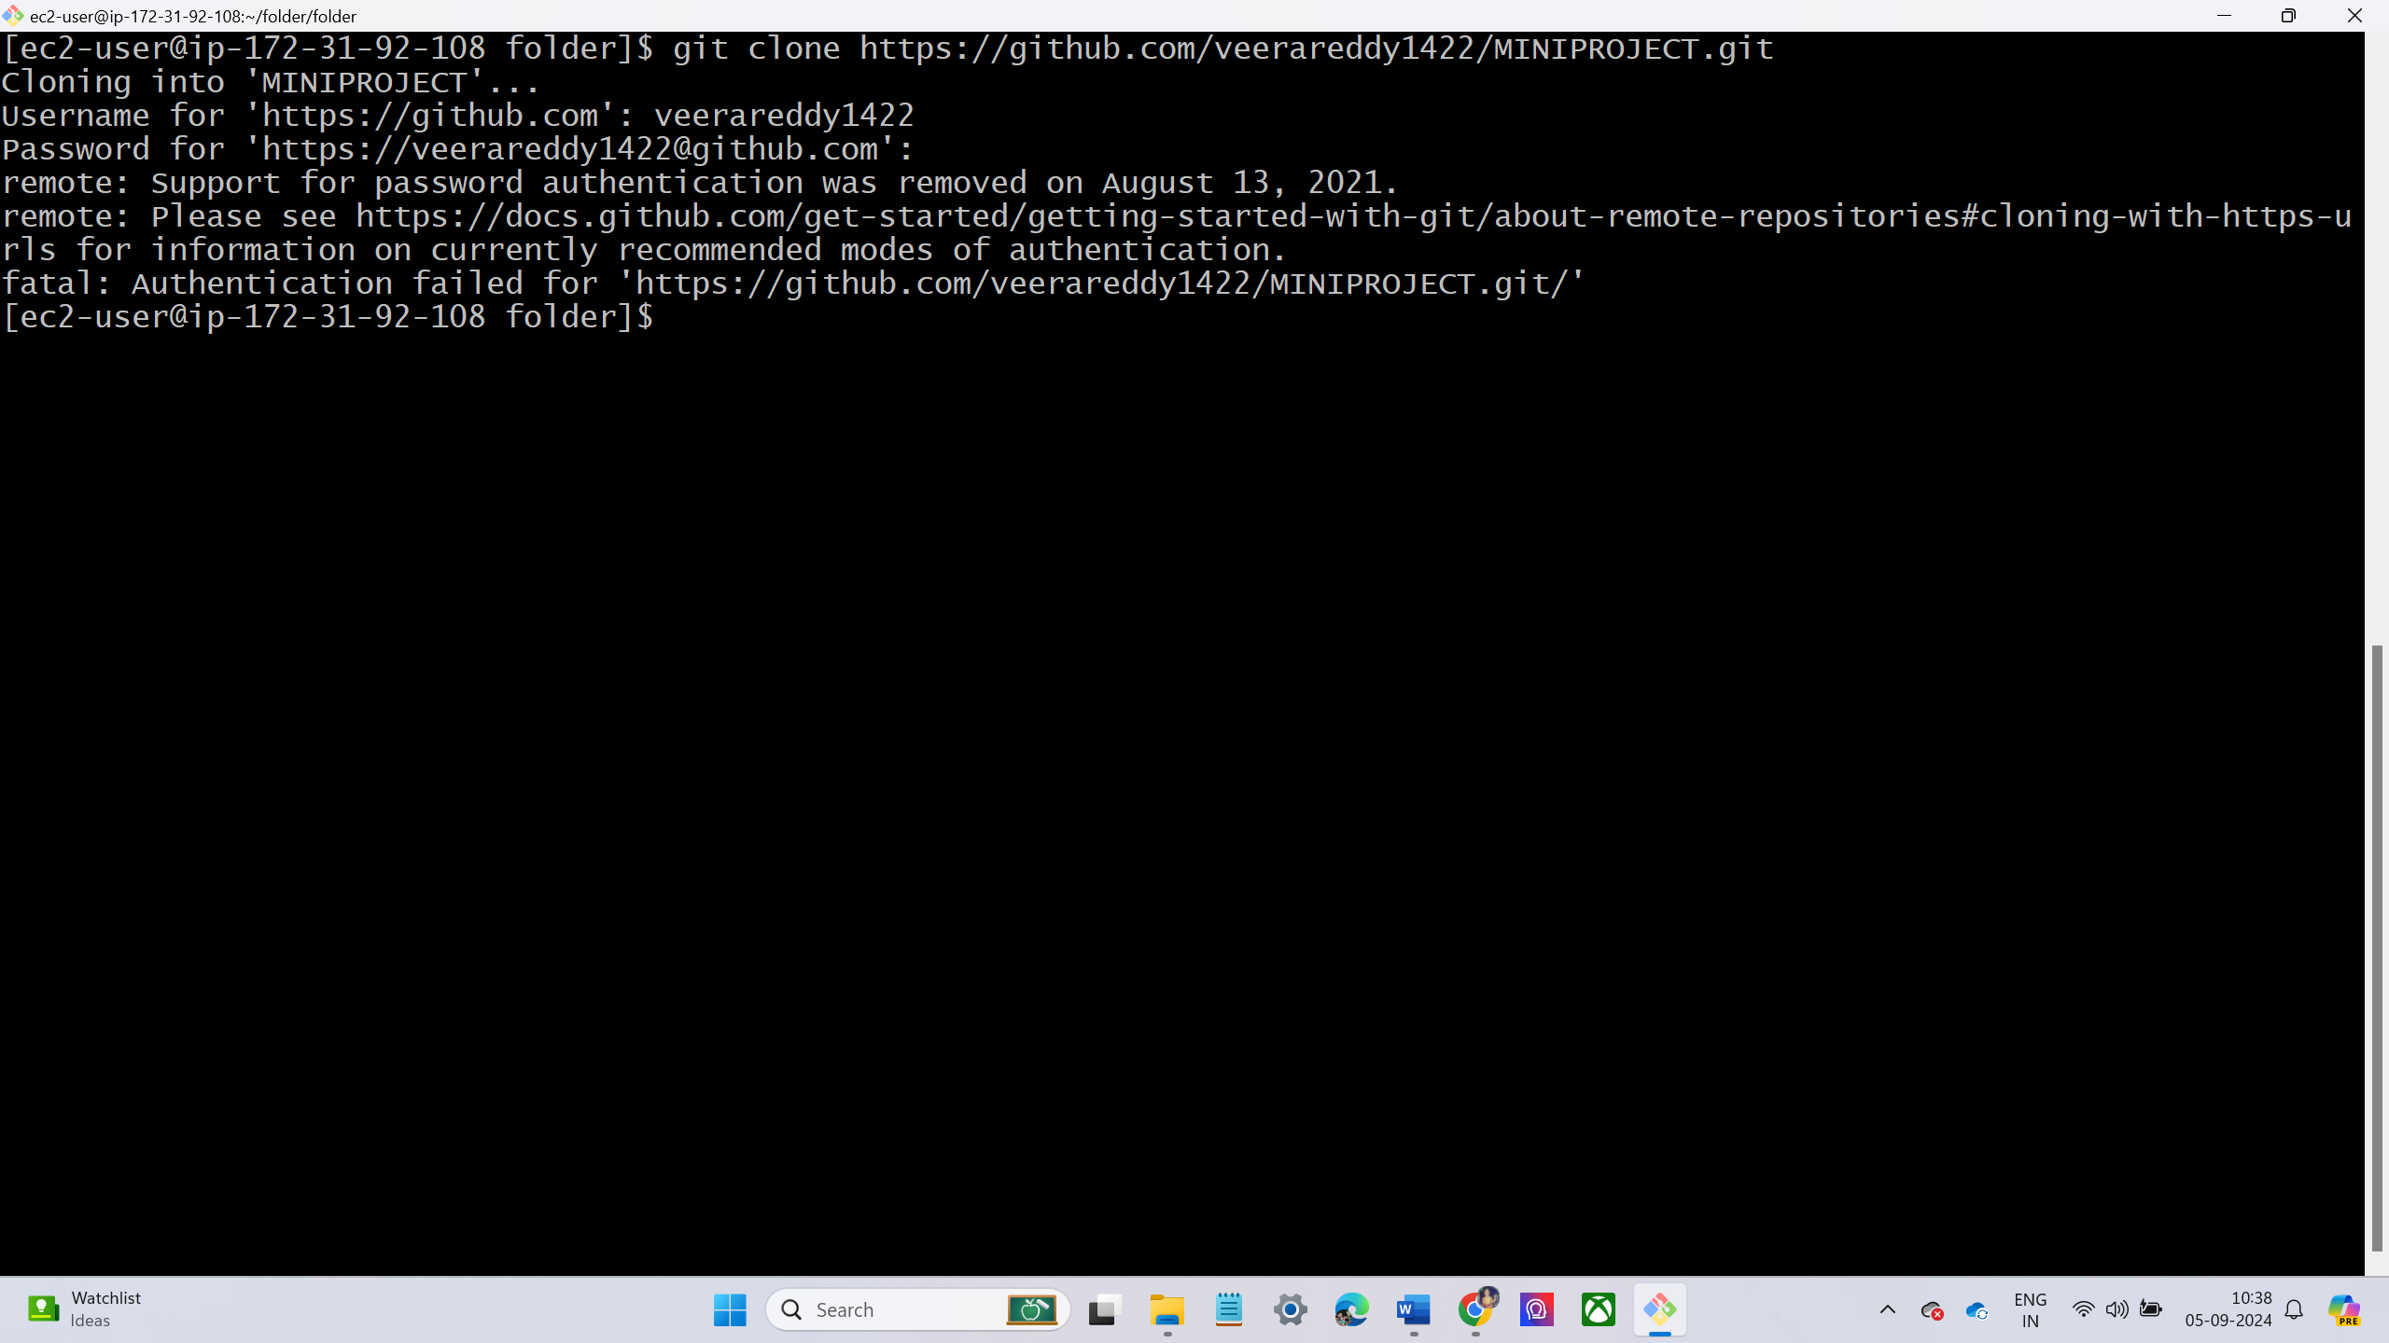
LAB -4 – WORKING WITH REMOTE REPOSITORY.
Clone the Remote Repository using command git clone.
After running the command, Git will ask you for your GitHub username and password.
You'll receive an error message due to the deprecation of password-based authentication.

Slide 9
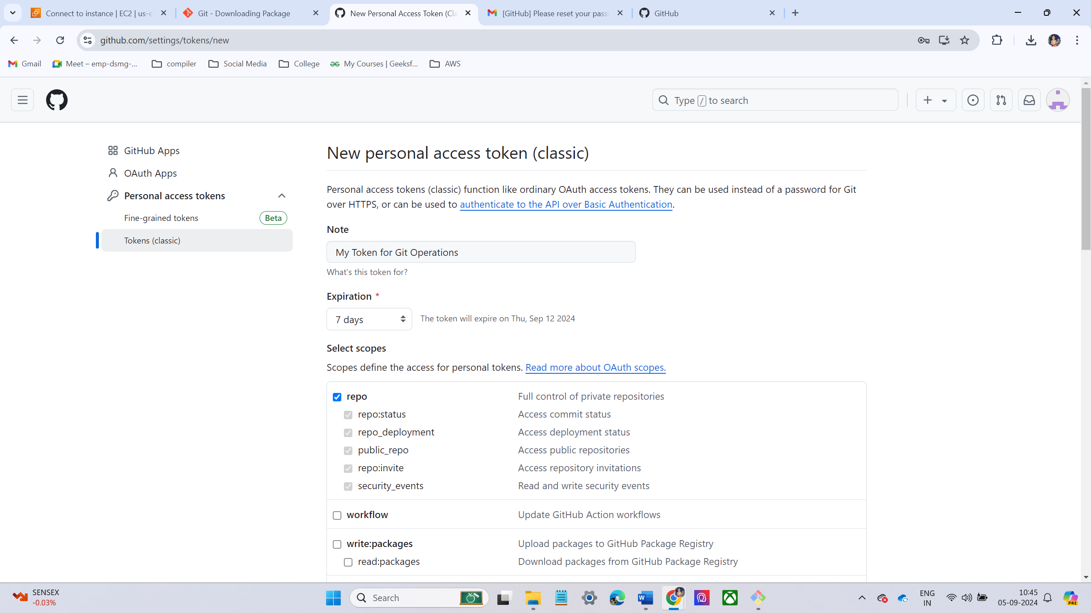
To overcome the above error, we can your personal access token.
Create a Personal Access Token.
Go to GitHub Settings -> Click on your profile picture at the top-right corner and select Settings.
Scroll down and select Developer settings from the left sidebar.
Create a New Token → Select Personal access tokens → Tokens (classic) → Generate new token

Slide 10
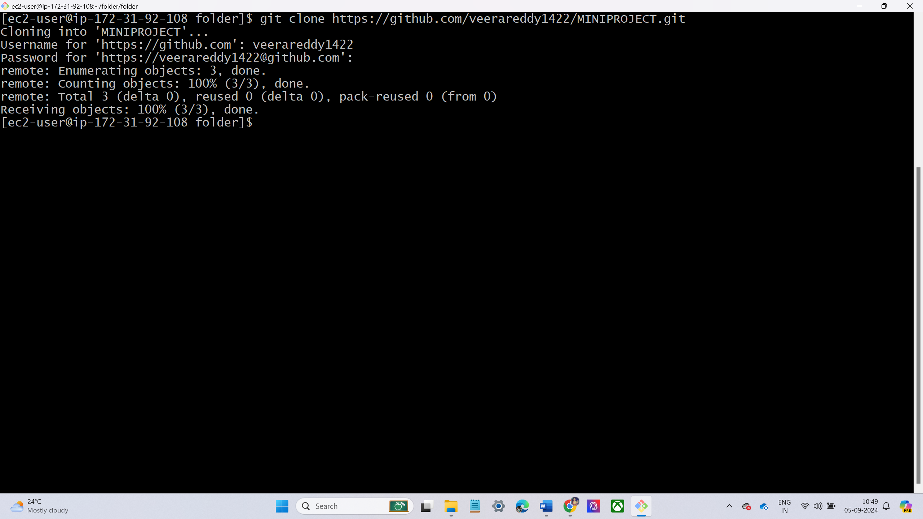
After generating token again clone the repository.
Again, ask username and password. In password give token address

Slide 11
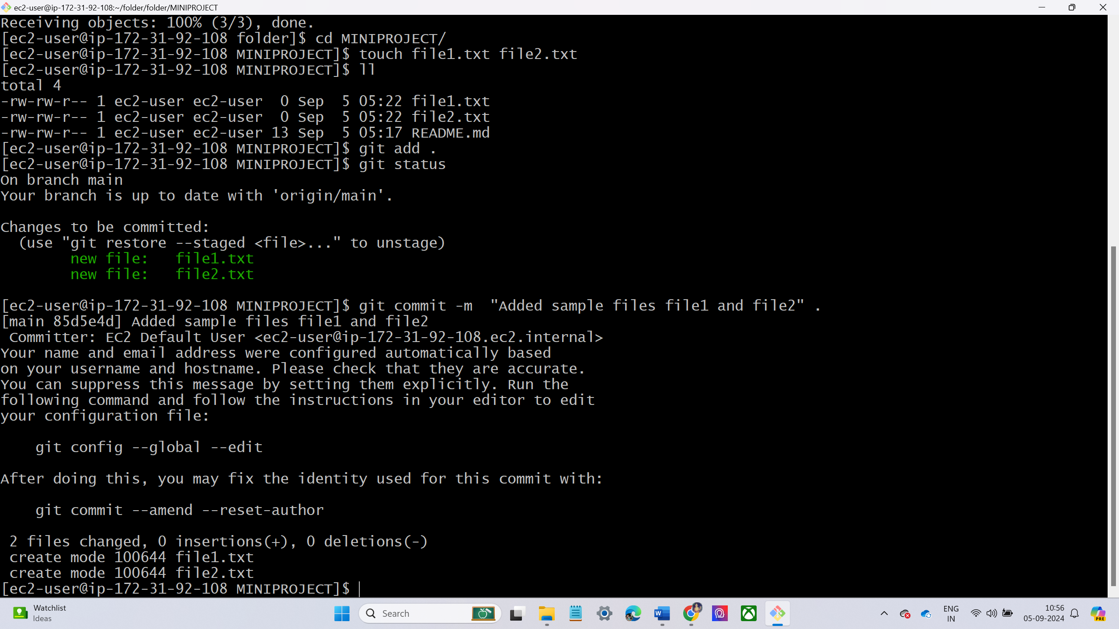
Make changes to local repository.
Go to cloned repository.
Create some sample files using touch command
Save changes
Stage the newly created files for the commit using git add command.
Commit the changes with a message using git commit command.

Slide 12
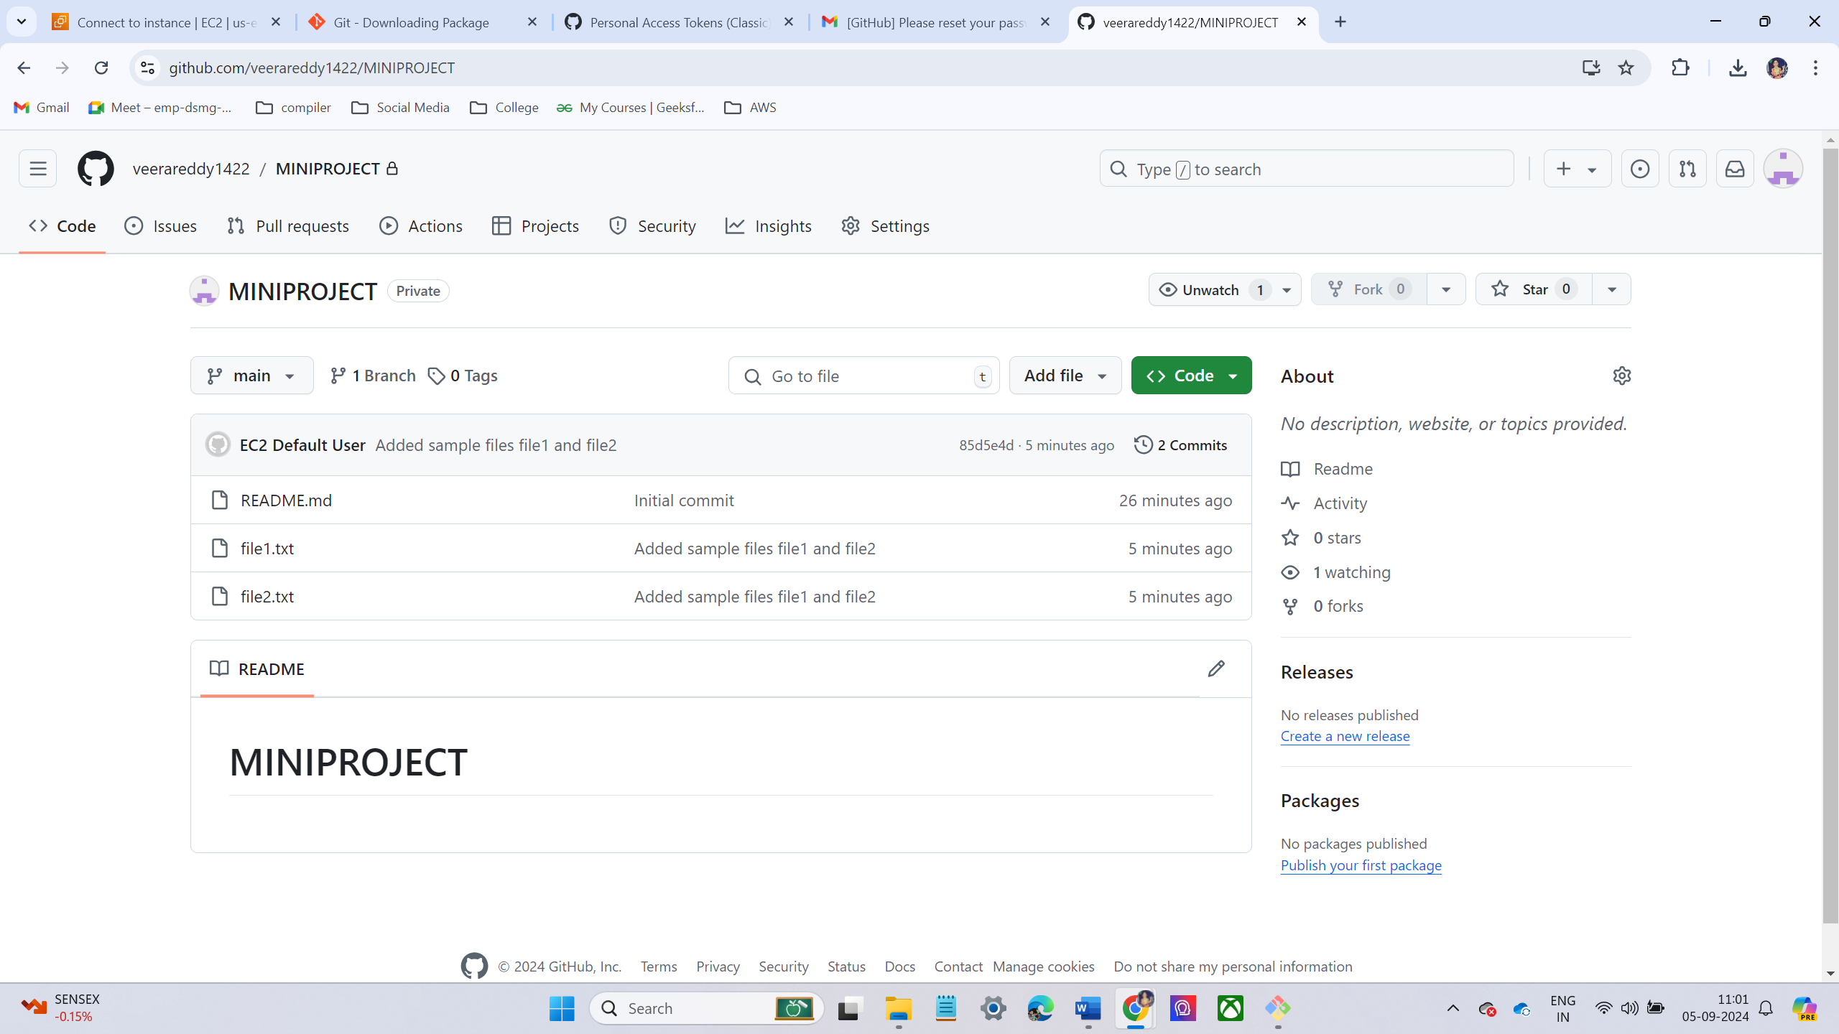
Push Changes to the Remote Repository
Run the git push command to push the committed changes to the remote repository.
Verify the Changes on GitHub.
Go to GitHub repository in the browser and refresh the page. Now see the new files (file1 and file2) that were pushed from local machine.

Slide 13
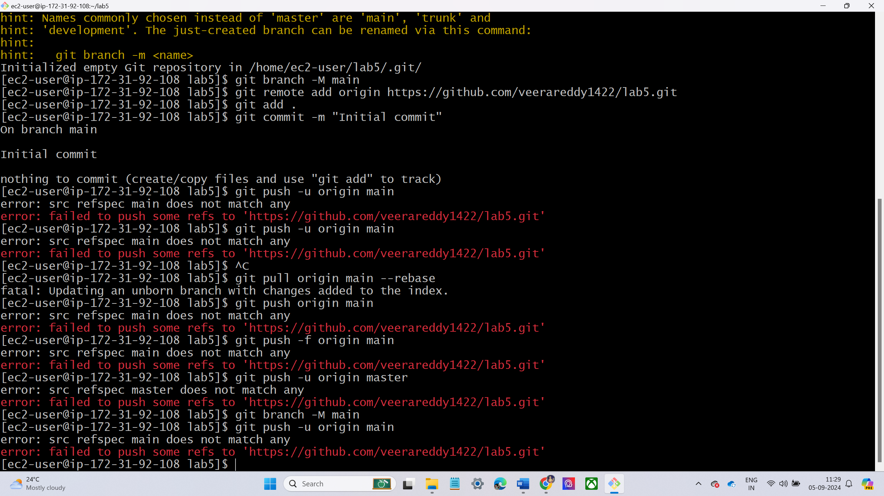

LAB – 5 – PUSHING A LOCALLY CREATED REPOSITORY TO GITHUB
Create a Folder for Local Repo using command mkdir.
Initialize the git on local repo using git init command
Create a New Repository on GitHub : Provide a name for the repository. Make sure the name is the same as local folder .Do not initialize the GitHub repository with a README, gitignore, or license.After creating the repository, you will be redirected to a page showing the repository URL (HTTPS or SSH). Copy the HTTPS URL.
Connect the Local Repo to the Remote GitHub Repo
Whenever I am pushing local repo to GitHub it shows as an error like below

Slide 14
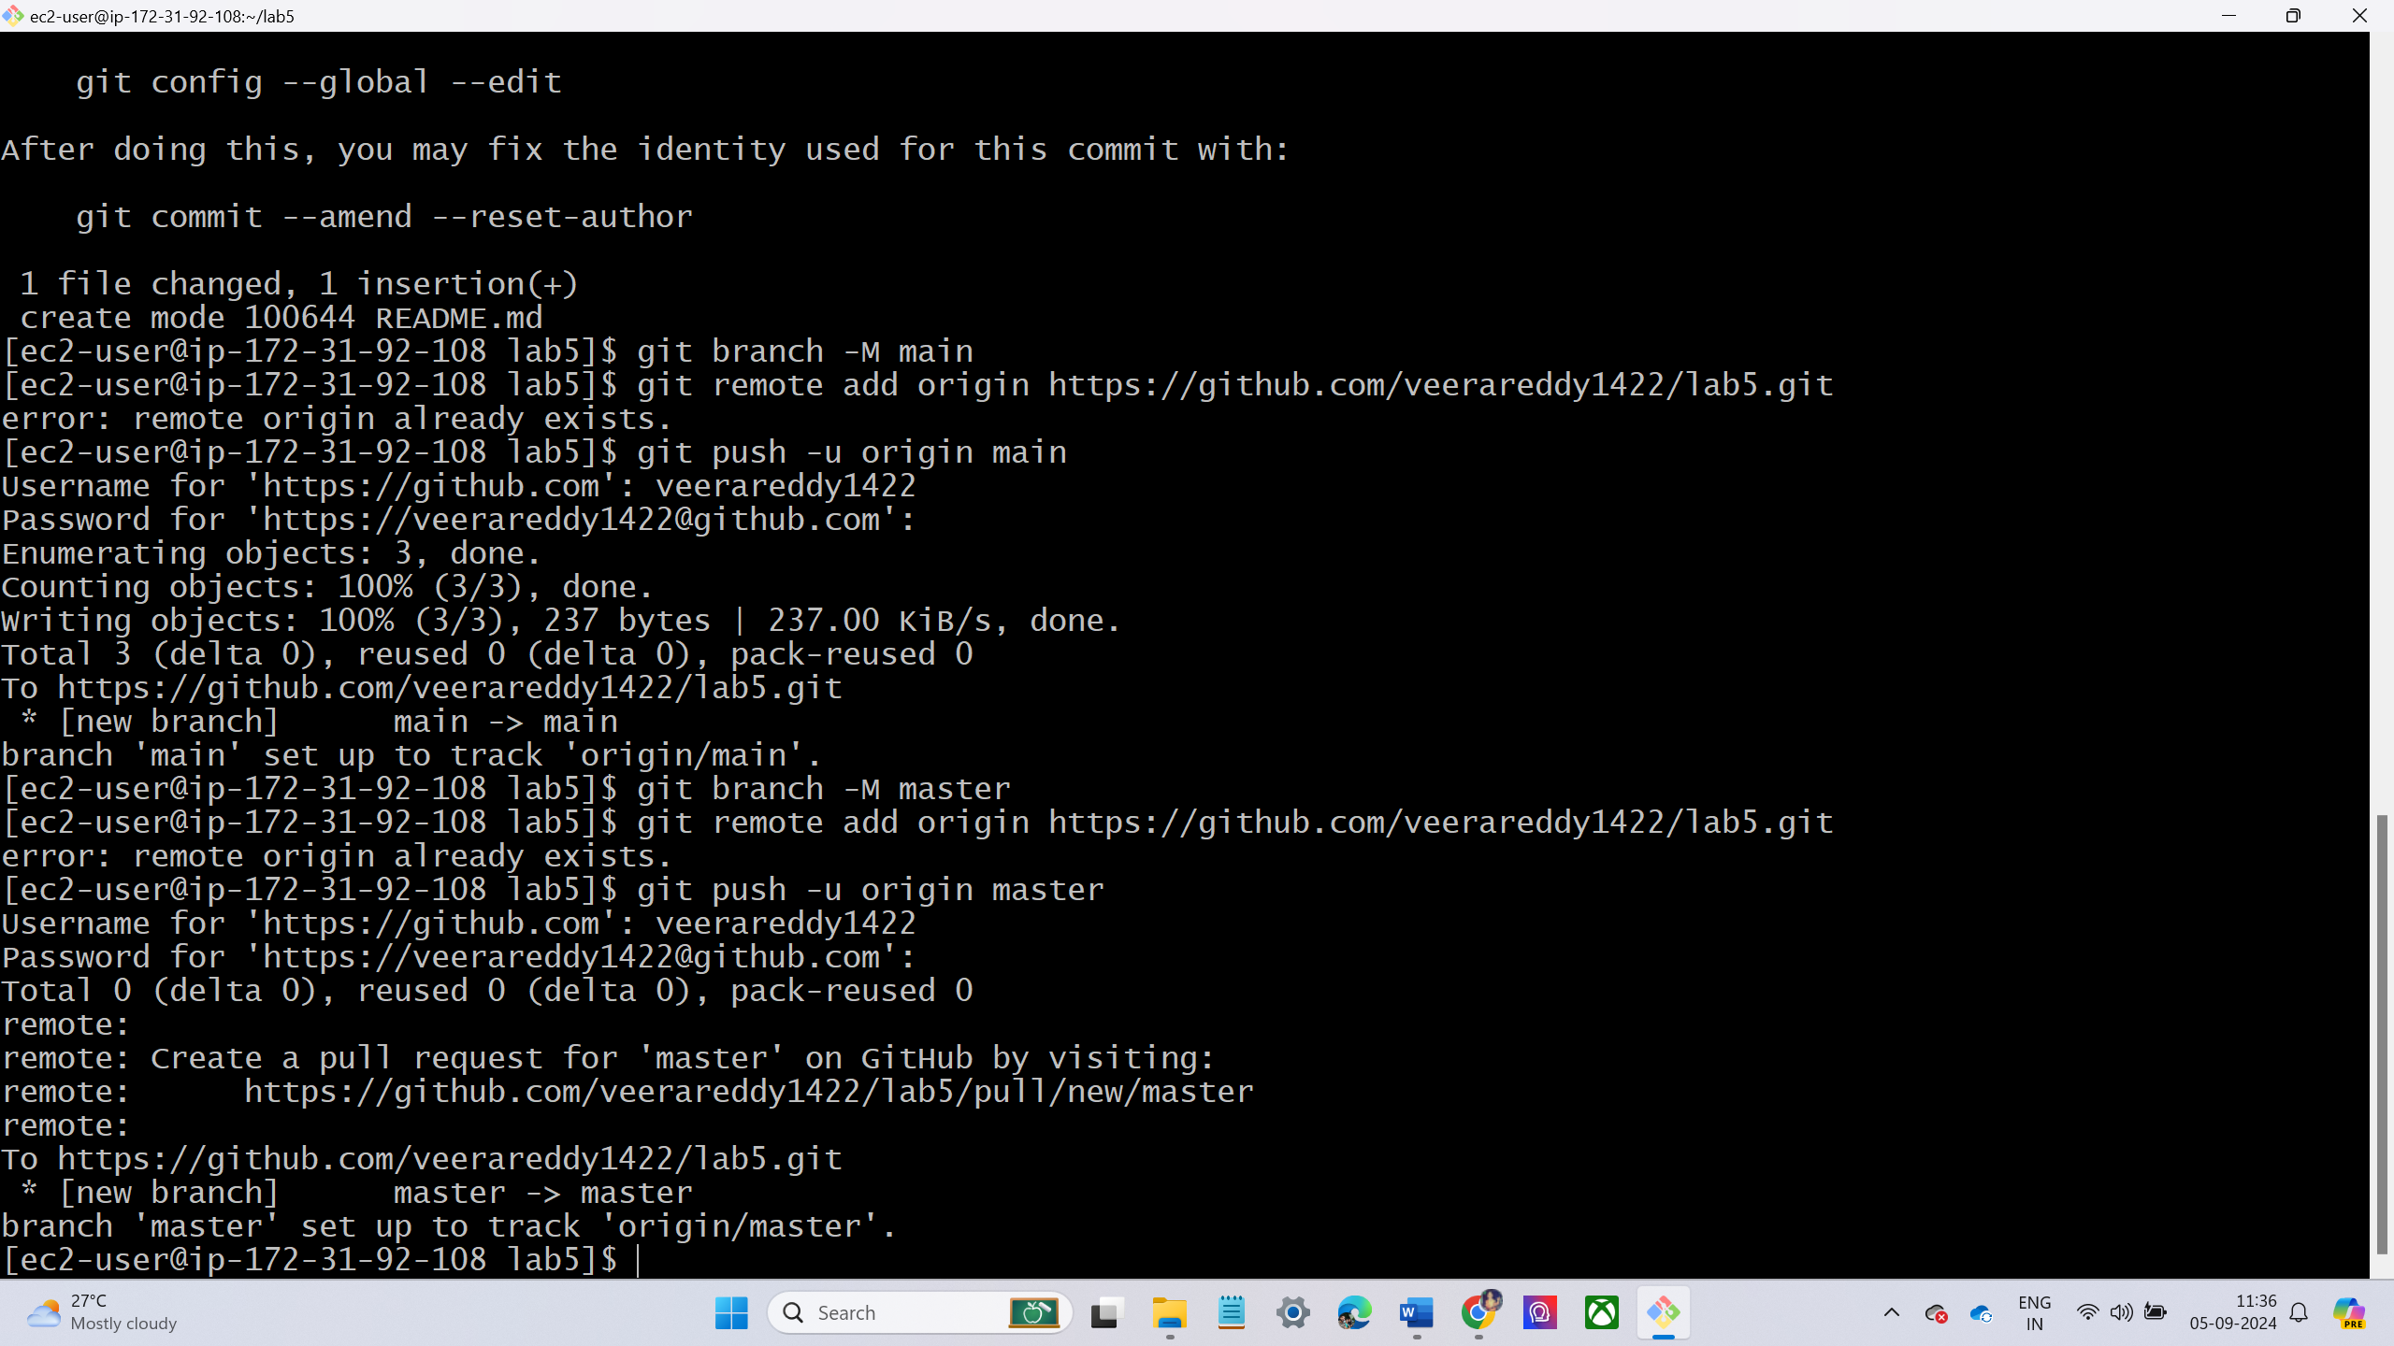
To overcome the above error, I have check the branch name.
I have created different branch name.
Again, I am pushing it works.

Slide 15
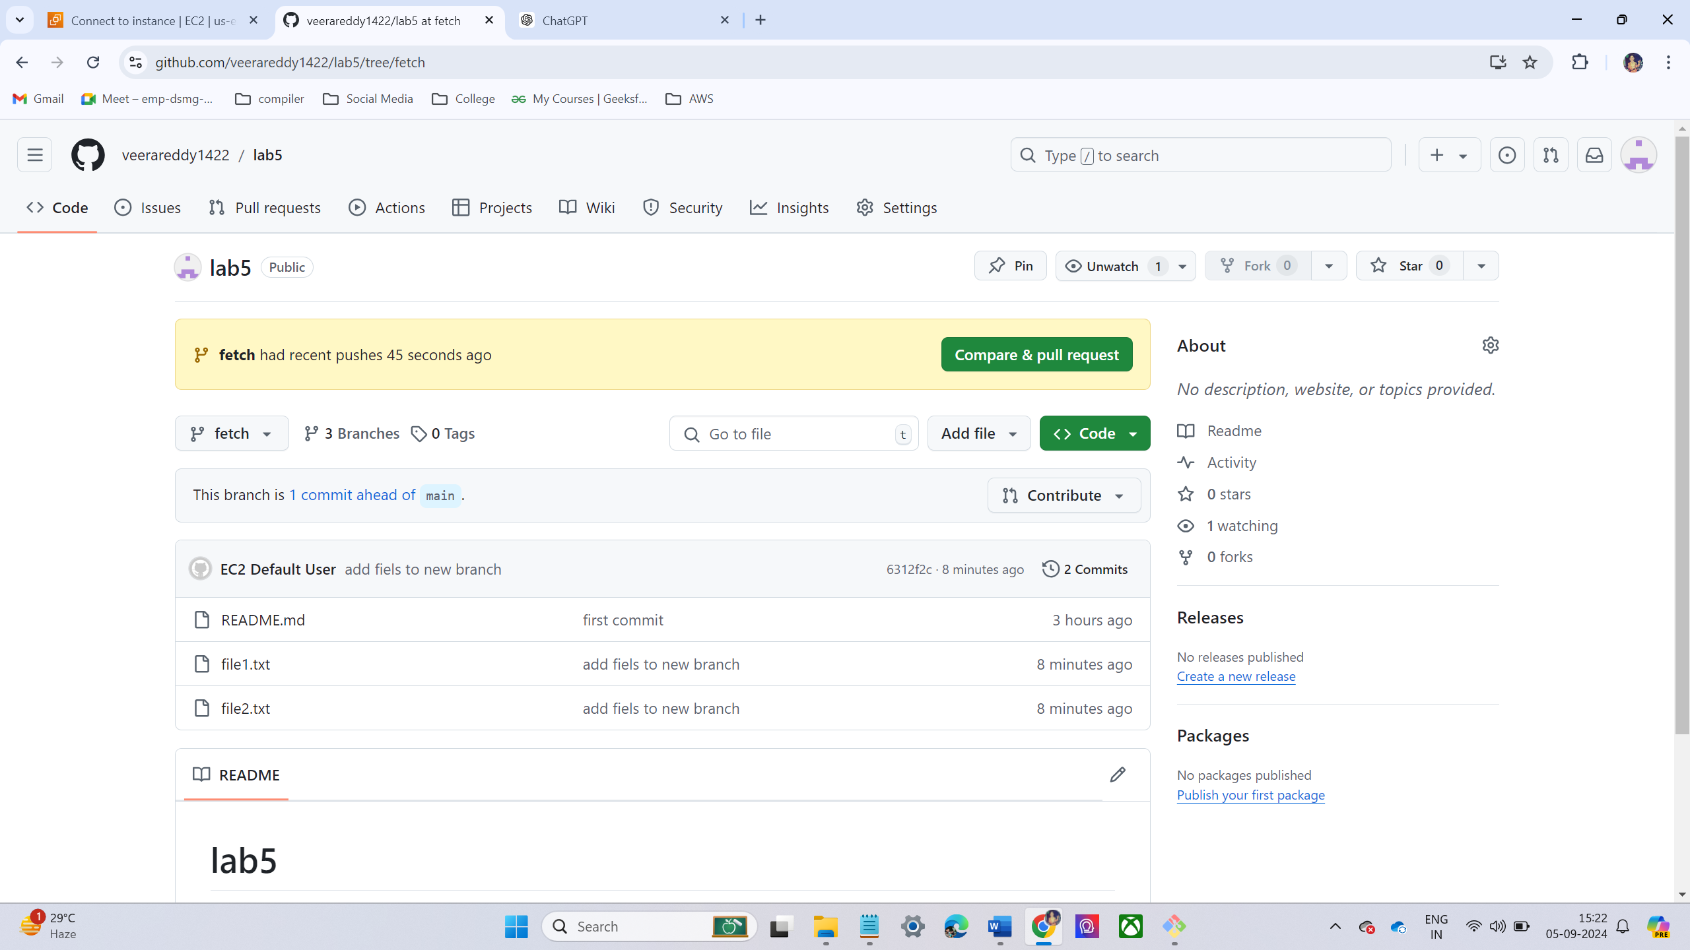

LAB – 6 CREATING NEW BRANCH FROM MAIN BRANCH
Go to Repo at the place of main and click view all branches.
Now click on New Branch
Now make some changes on newly created branch
I have created some text files in new branch
The changes are occurring only in new branch not in main branch
The changes are shown in the figure below.

Slide 16
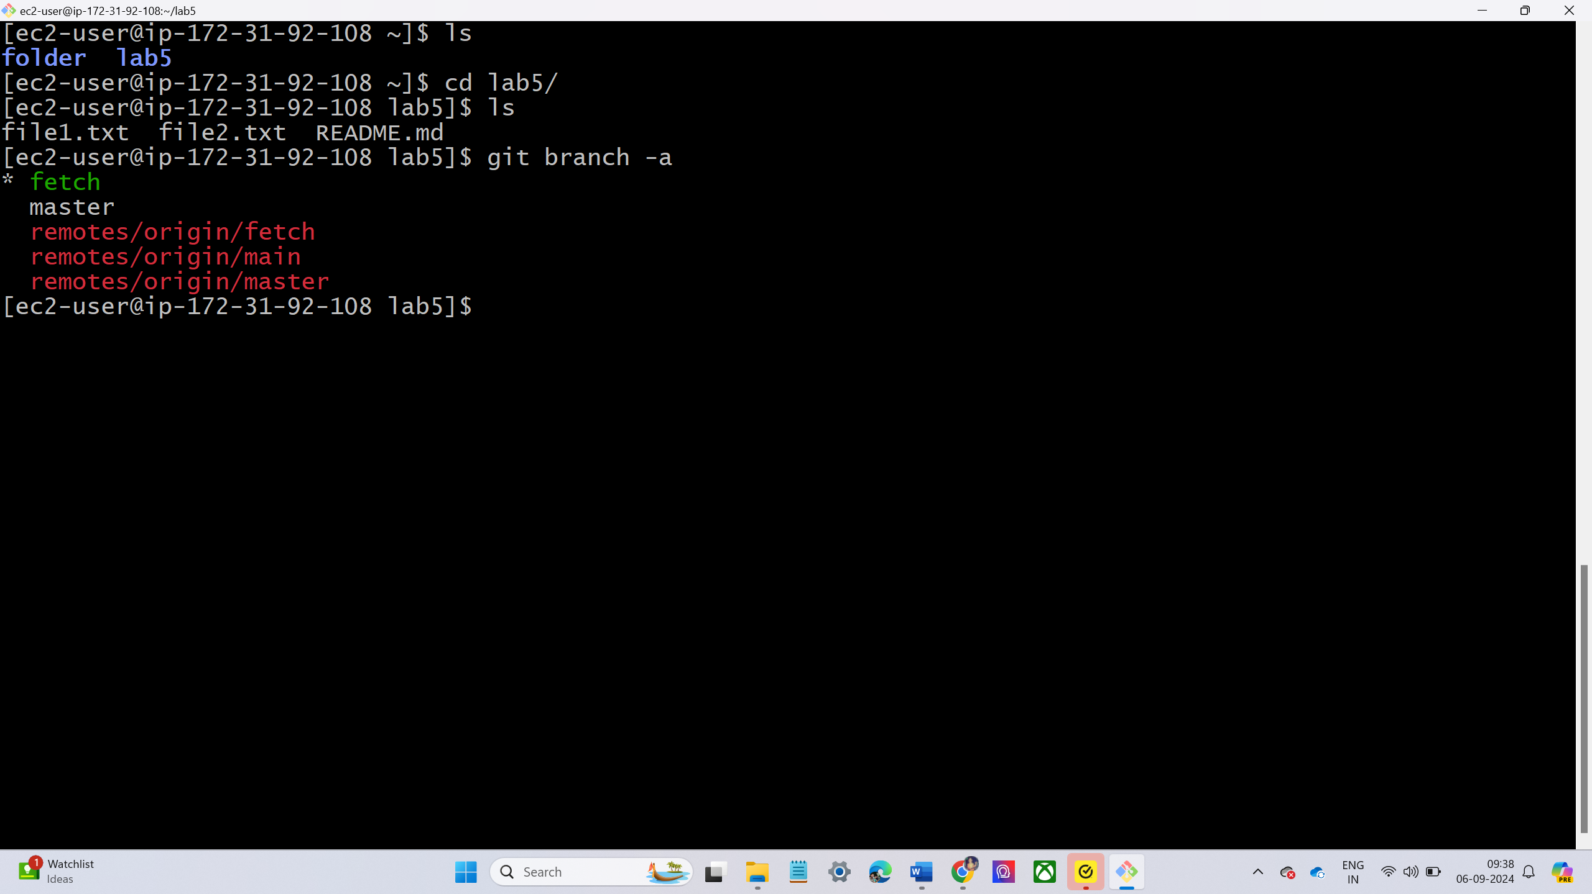
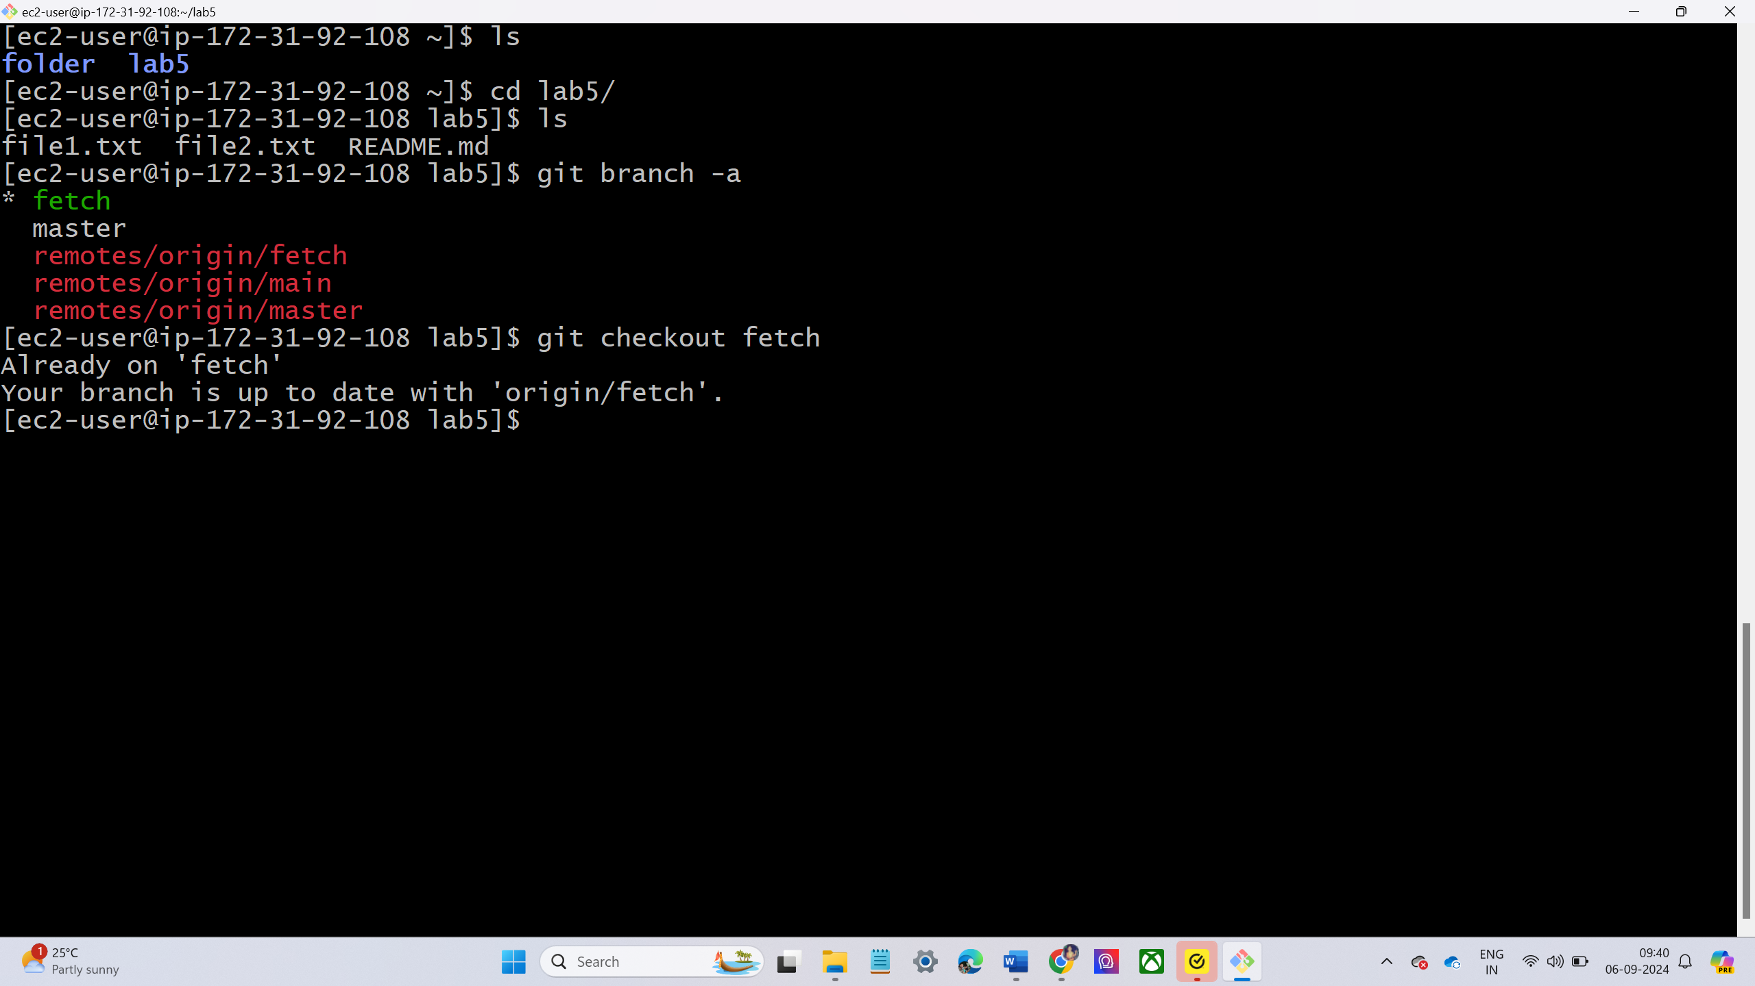
LAB-7—PULL ALL BRANCHES IN YOUR LOCAL MACHINE
List out all branches.
Go to local machine with git repository and run command git branch –a
Checkout to the Feature Branch.
switch to the feature branch you want to work on by running using command
git checkout <branch name>

Slide 17
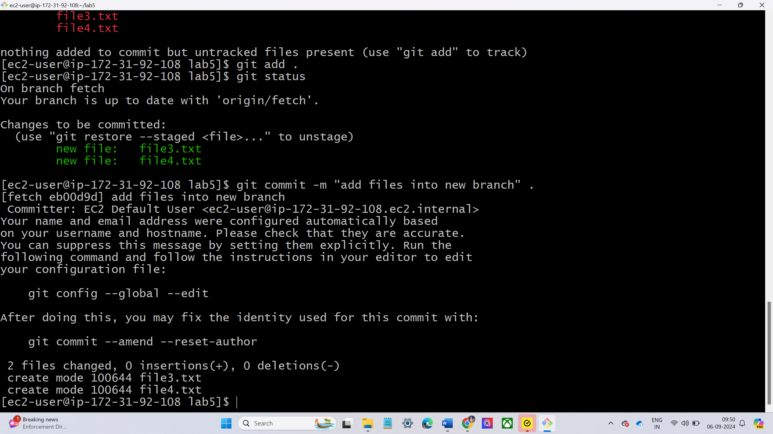
verify the status of the new branch using command git status.
Add new files into the branch
Before adding we can create the file and then add it into the branch.
For creating the files using the command touch <files name>.
Now again check the status
Now move the files into the branch
For moving the files into staging area using the command git add.
Now commit the files using command git commit -m <message > filename.

Slide 18
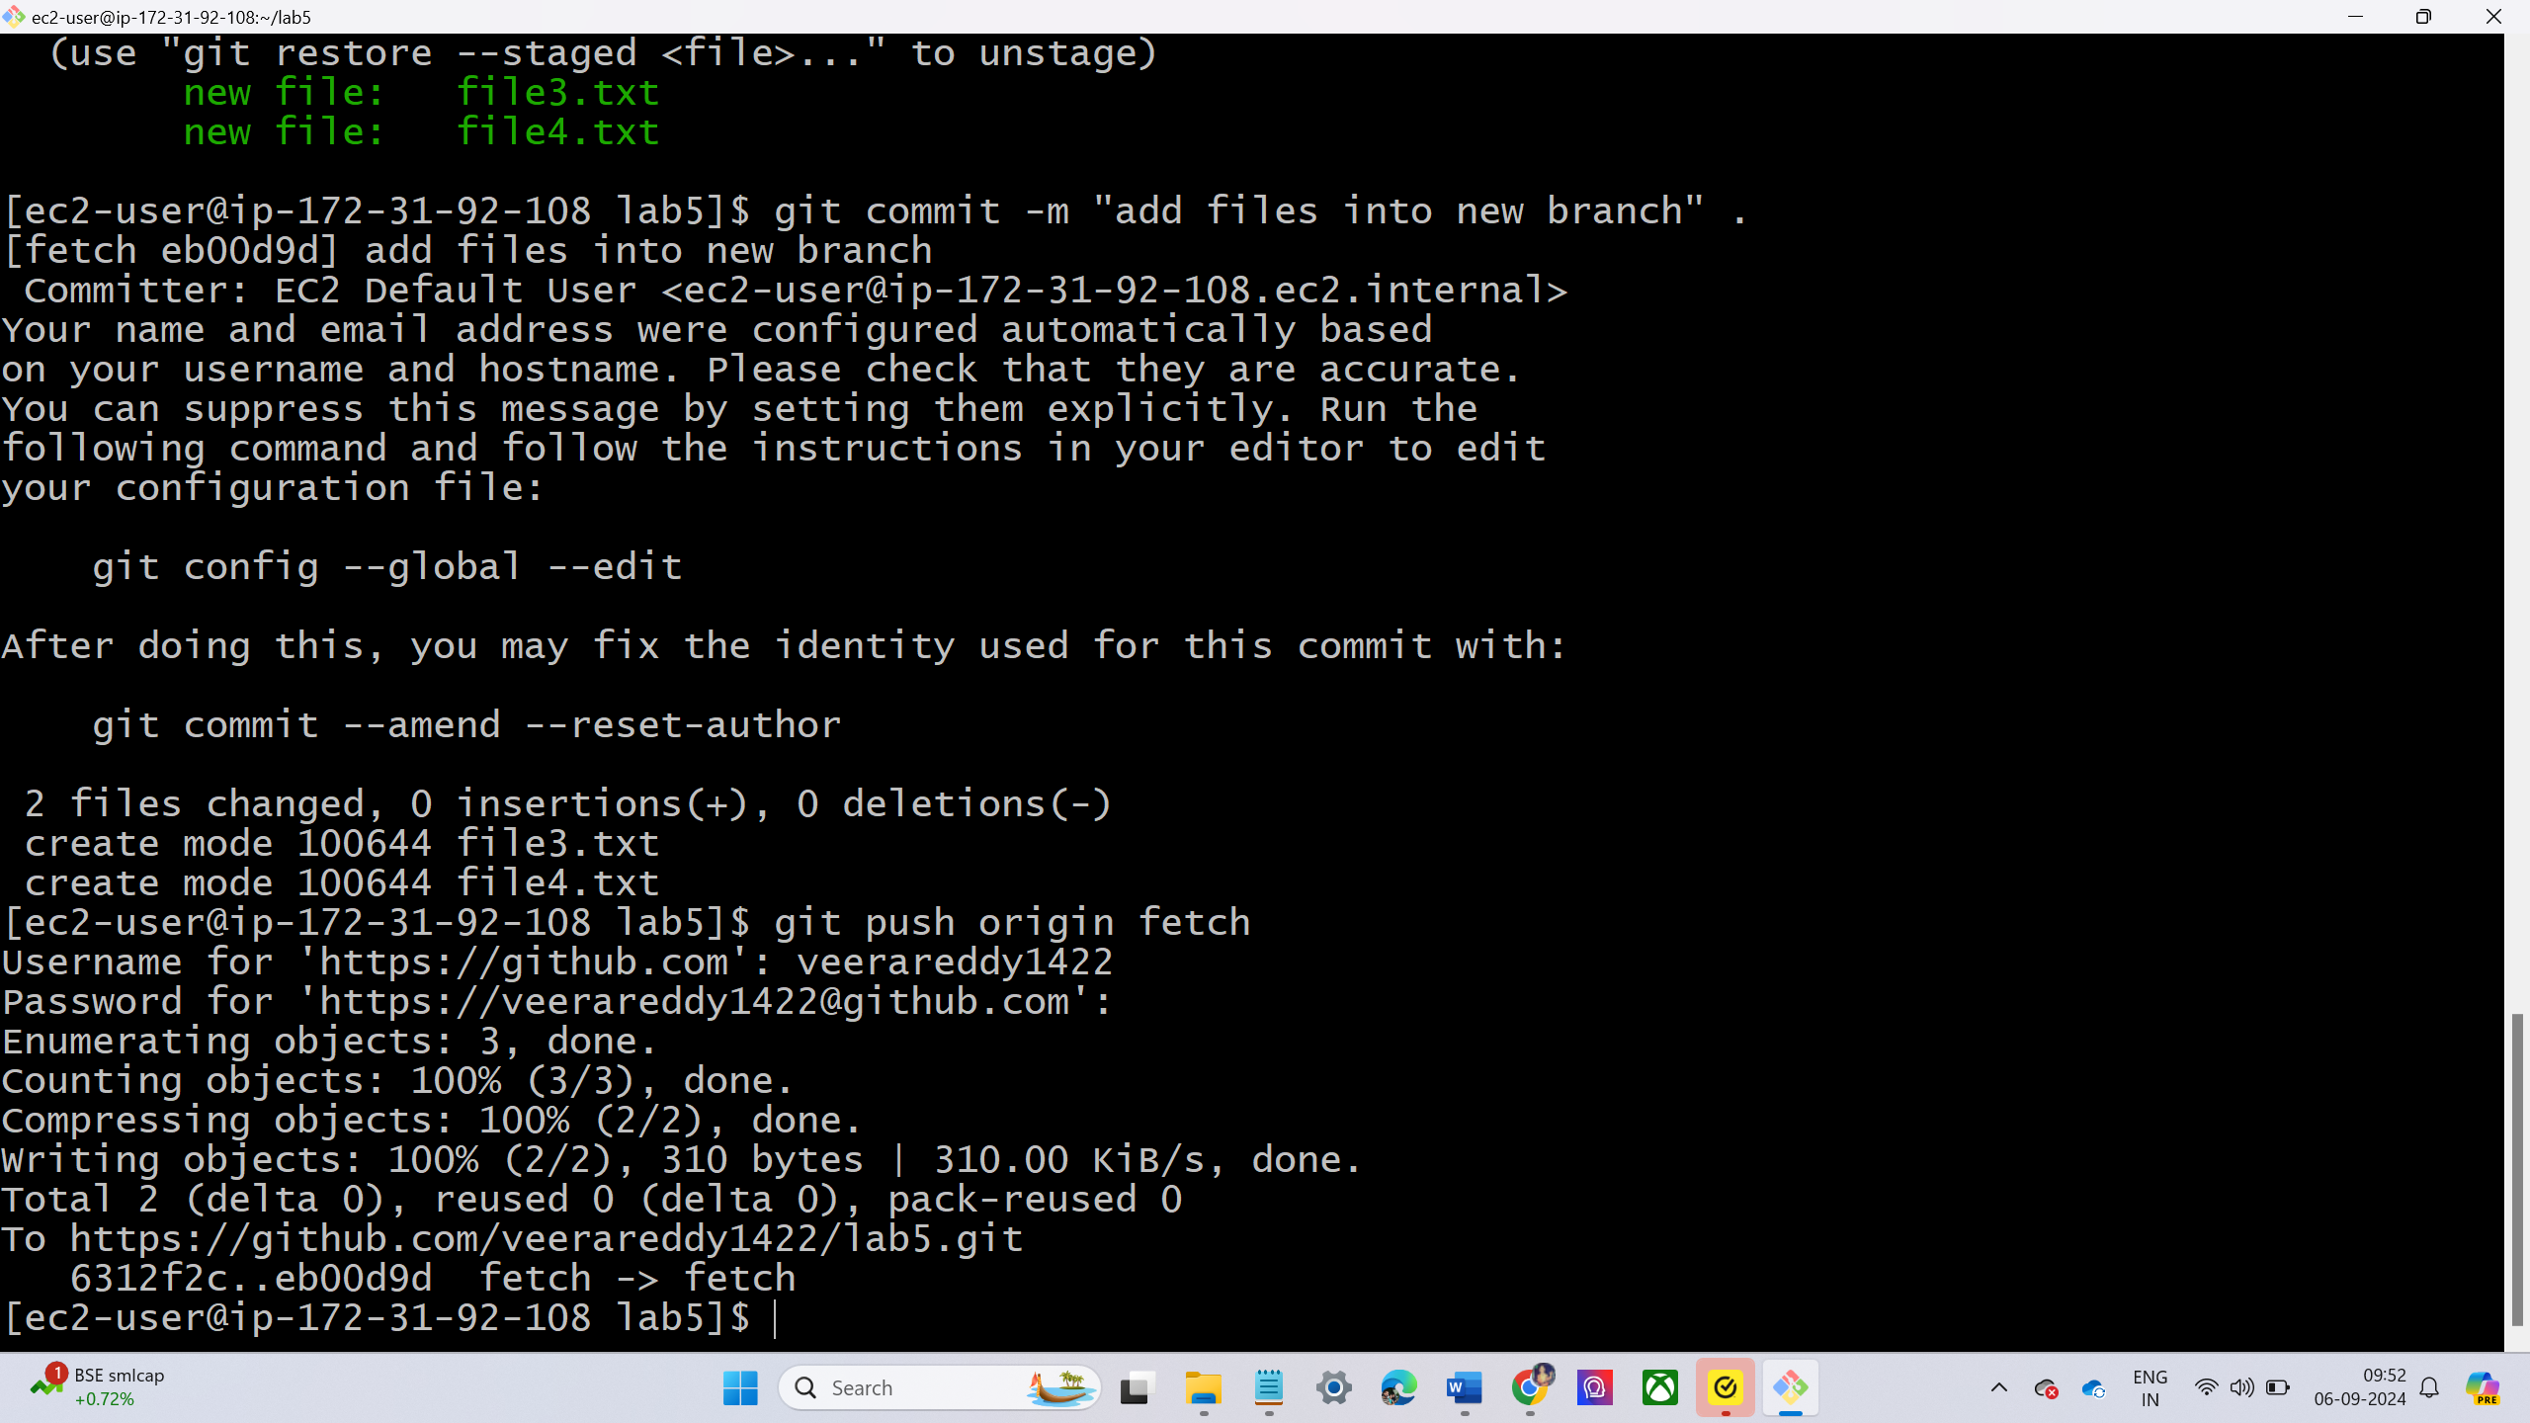
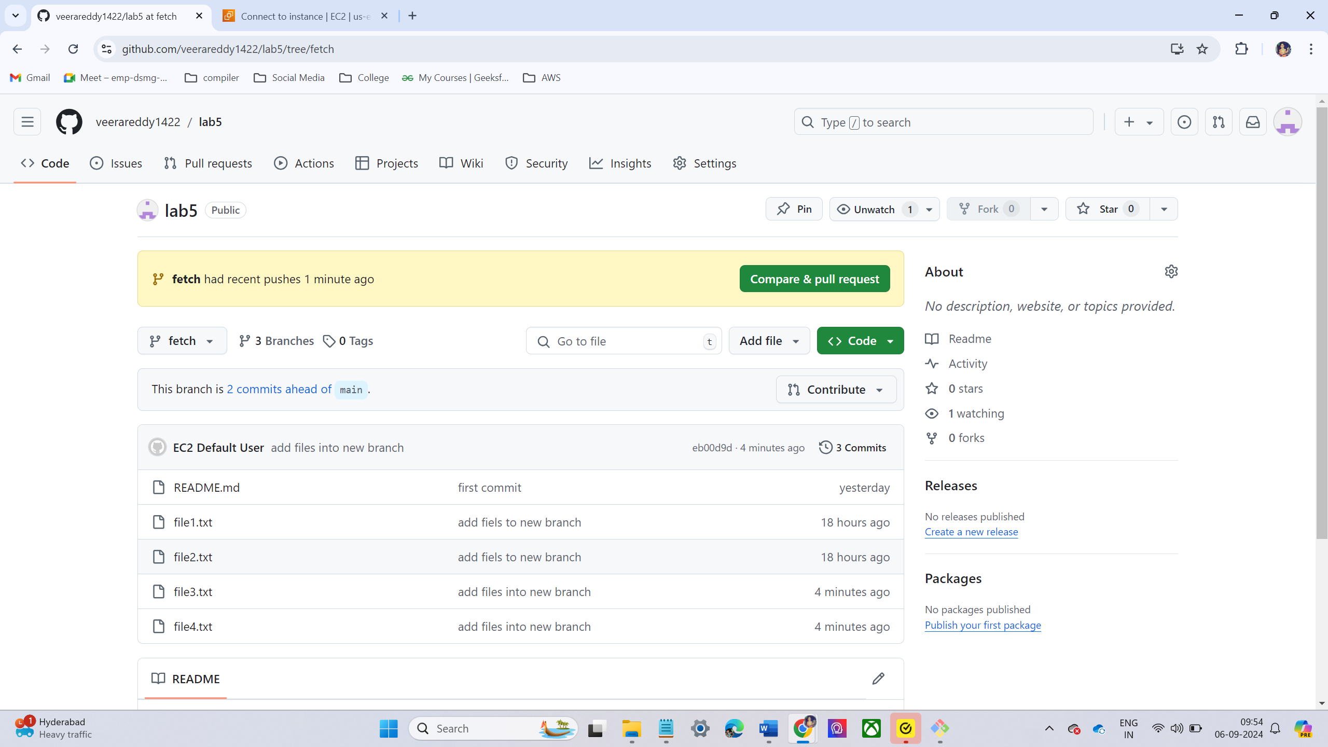
Push the changes into remote branch using git push command
Now check the files in remote branch in git hub
The new changes are present in your feature branch

Slide 19
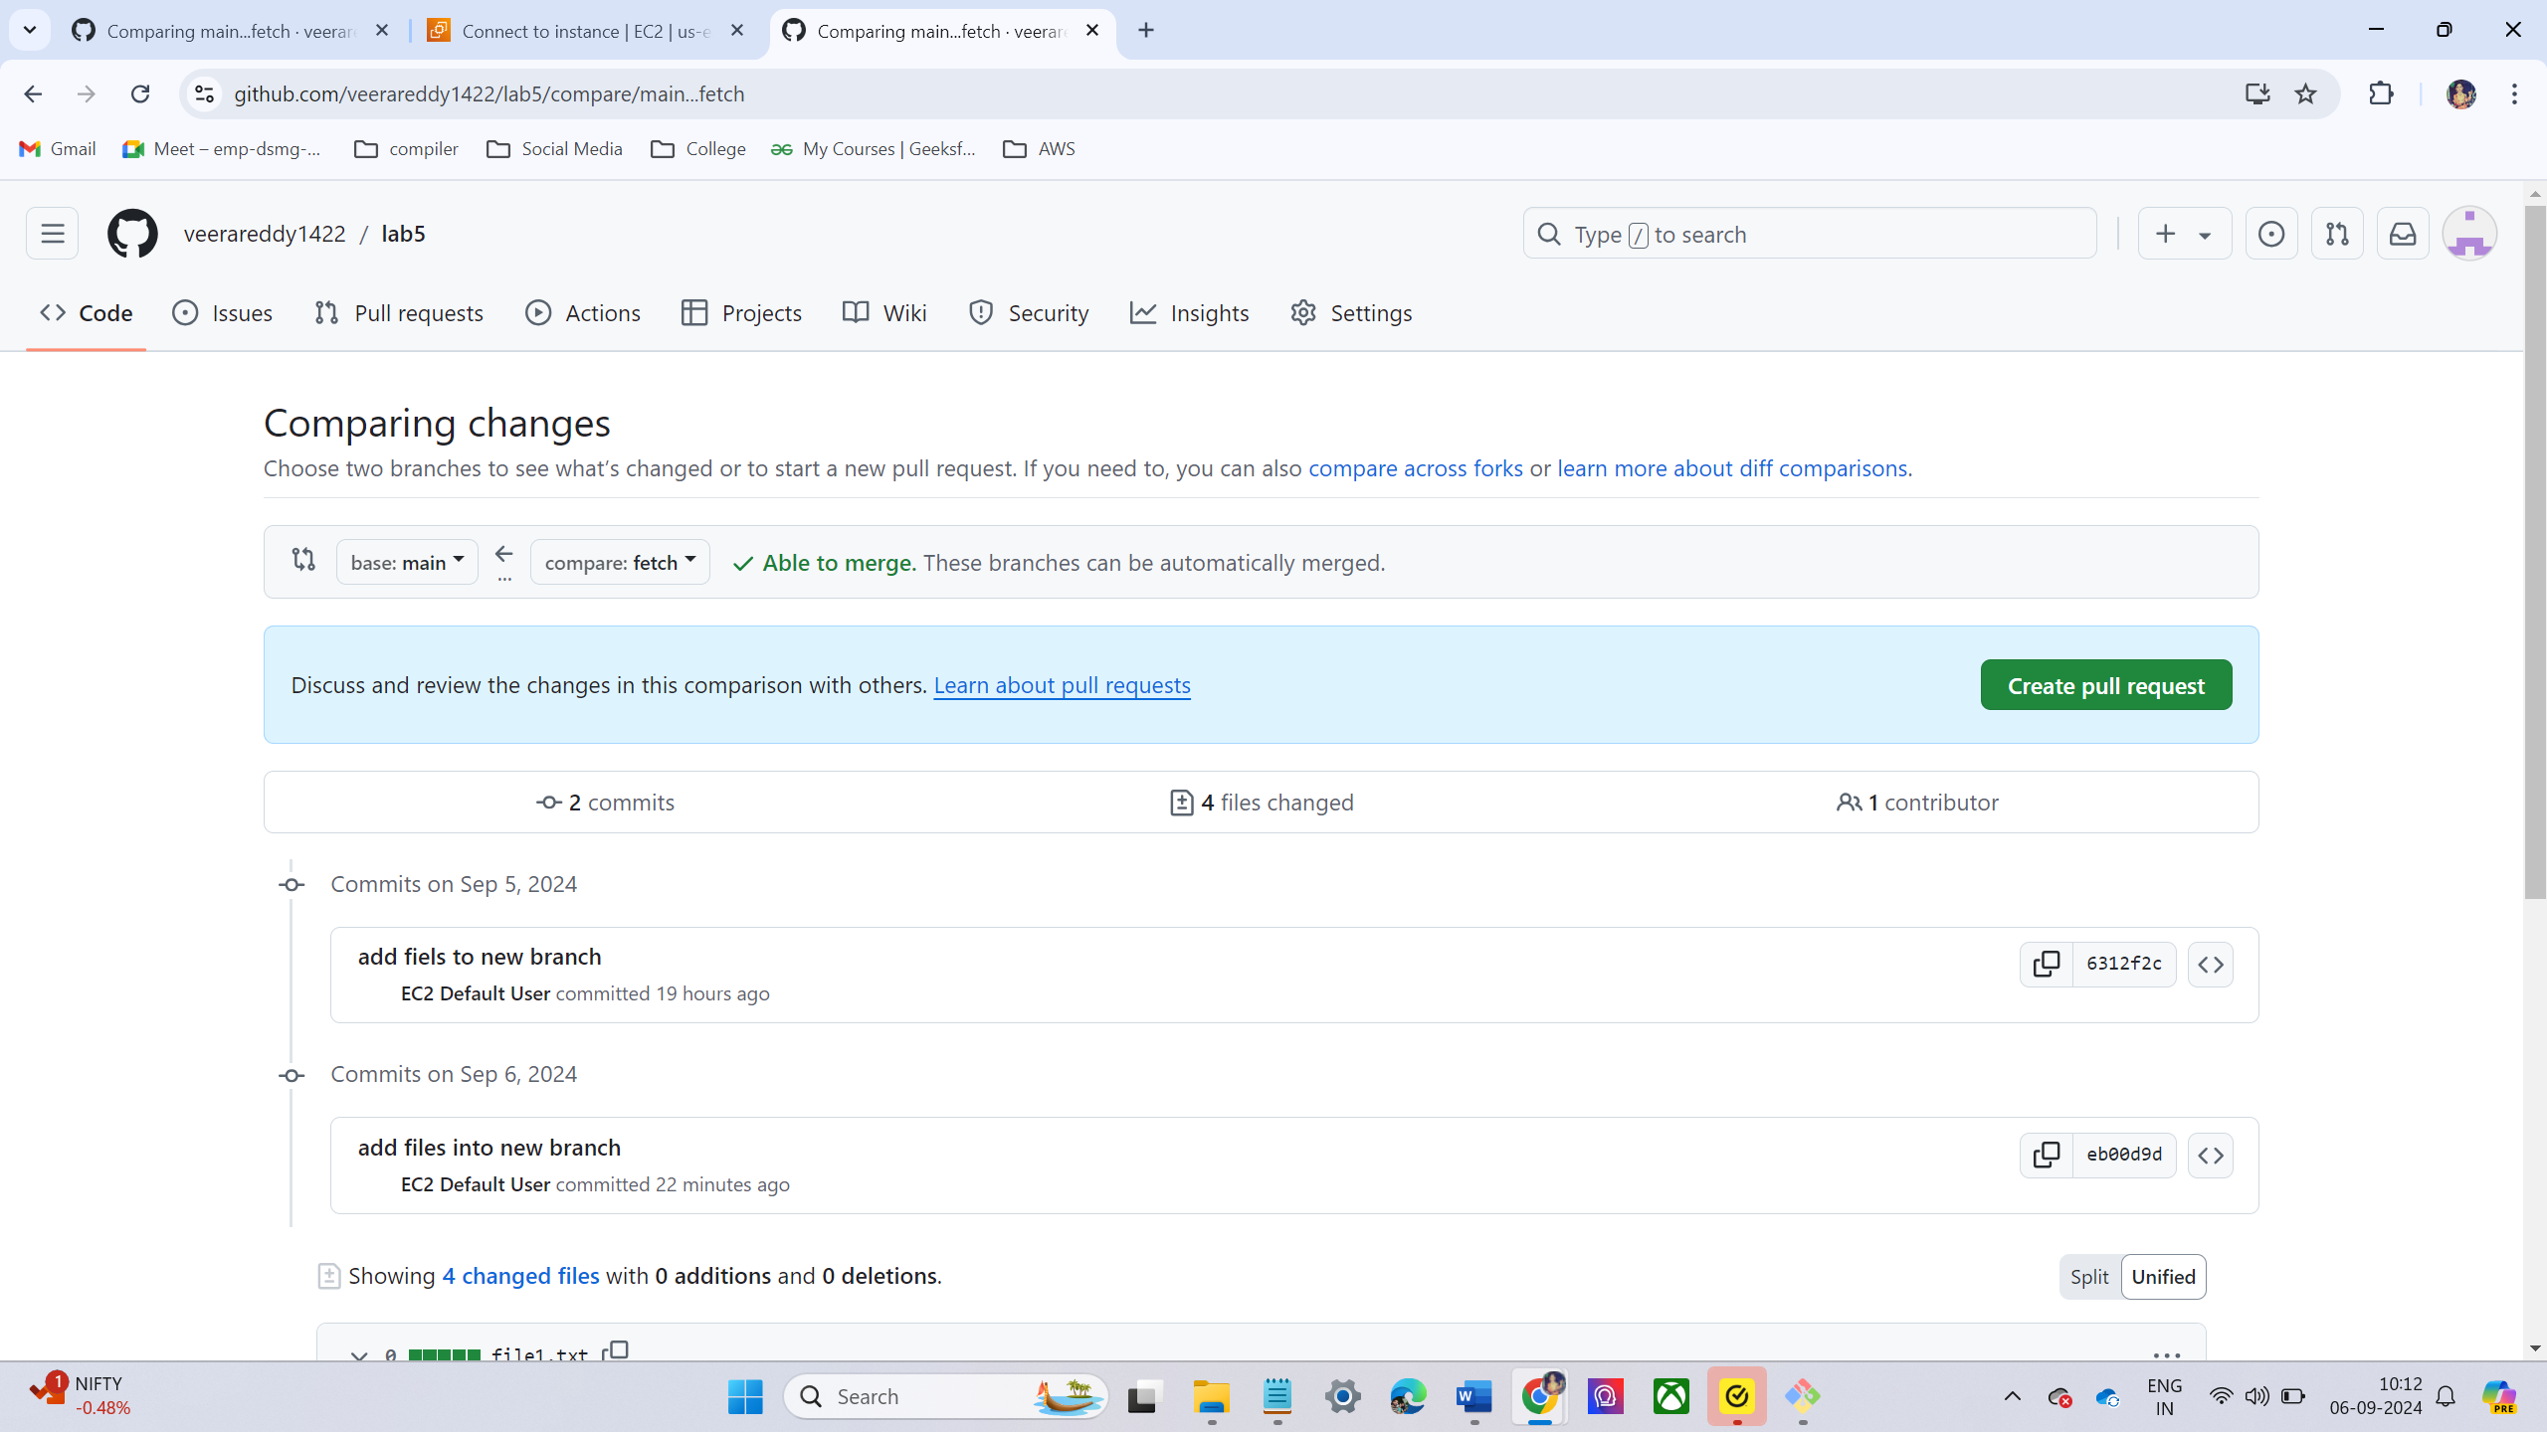
LAB – 8 MERGE OUR FUTURE IN TO MAIN BRANCH
Go to GitHub account and go repository
Click branch down into new branch
Now check the changes of the branch.
Now go to pull requests tab
Go to left top →click settings → now click pull request
Click on new pull request.
In base branch drop down select main branch.
In compare branch drop down select fetch branch

Slide 20
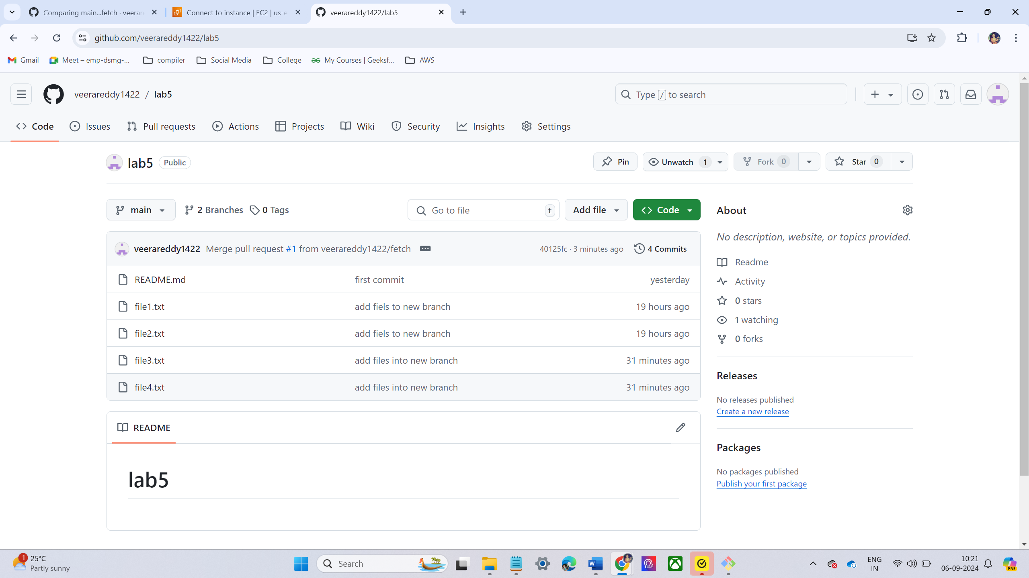
Now click Create pull request.
A new window will open where can add a comment or a description for the pull request
After adding comments, click Create Pull Request again.
Review and Merge the Pull Request
Confirm by clicking Confirm Merge
After merging, GitHub will offer the option to Delete Branch. click this if you no longer need the feature branch, or simply leave it as is.
Verify the Changes in the Main Branch
Go to the Code tab and verify that the changes from the feature branch (e.g., file3 and file4) are now present in the main branch

Slide 21
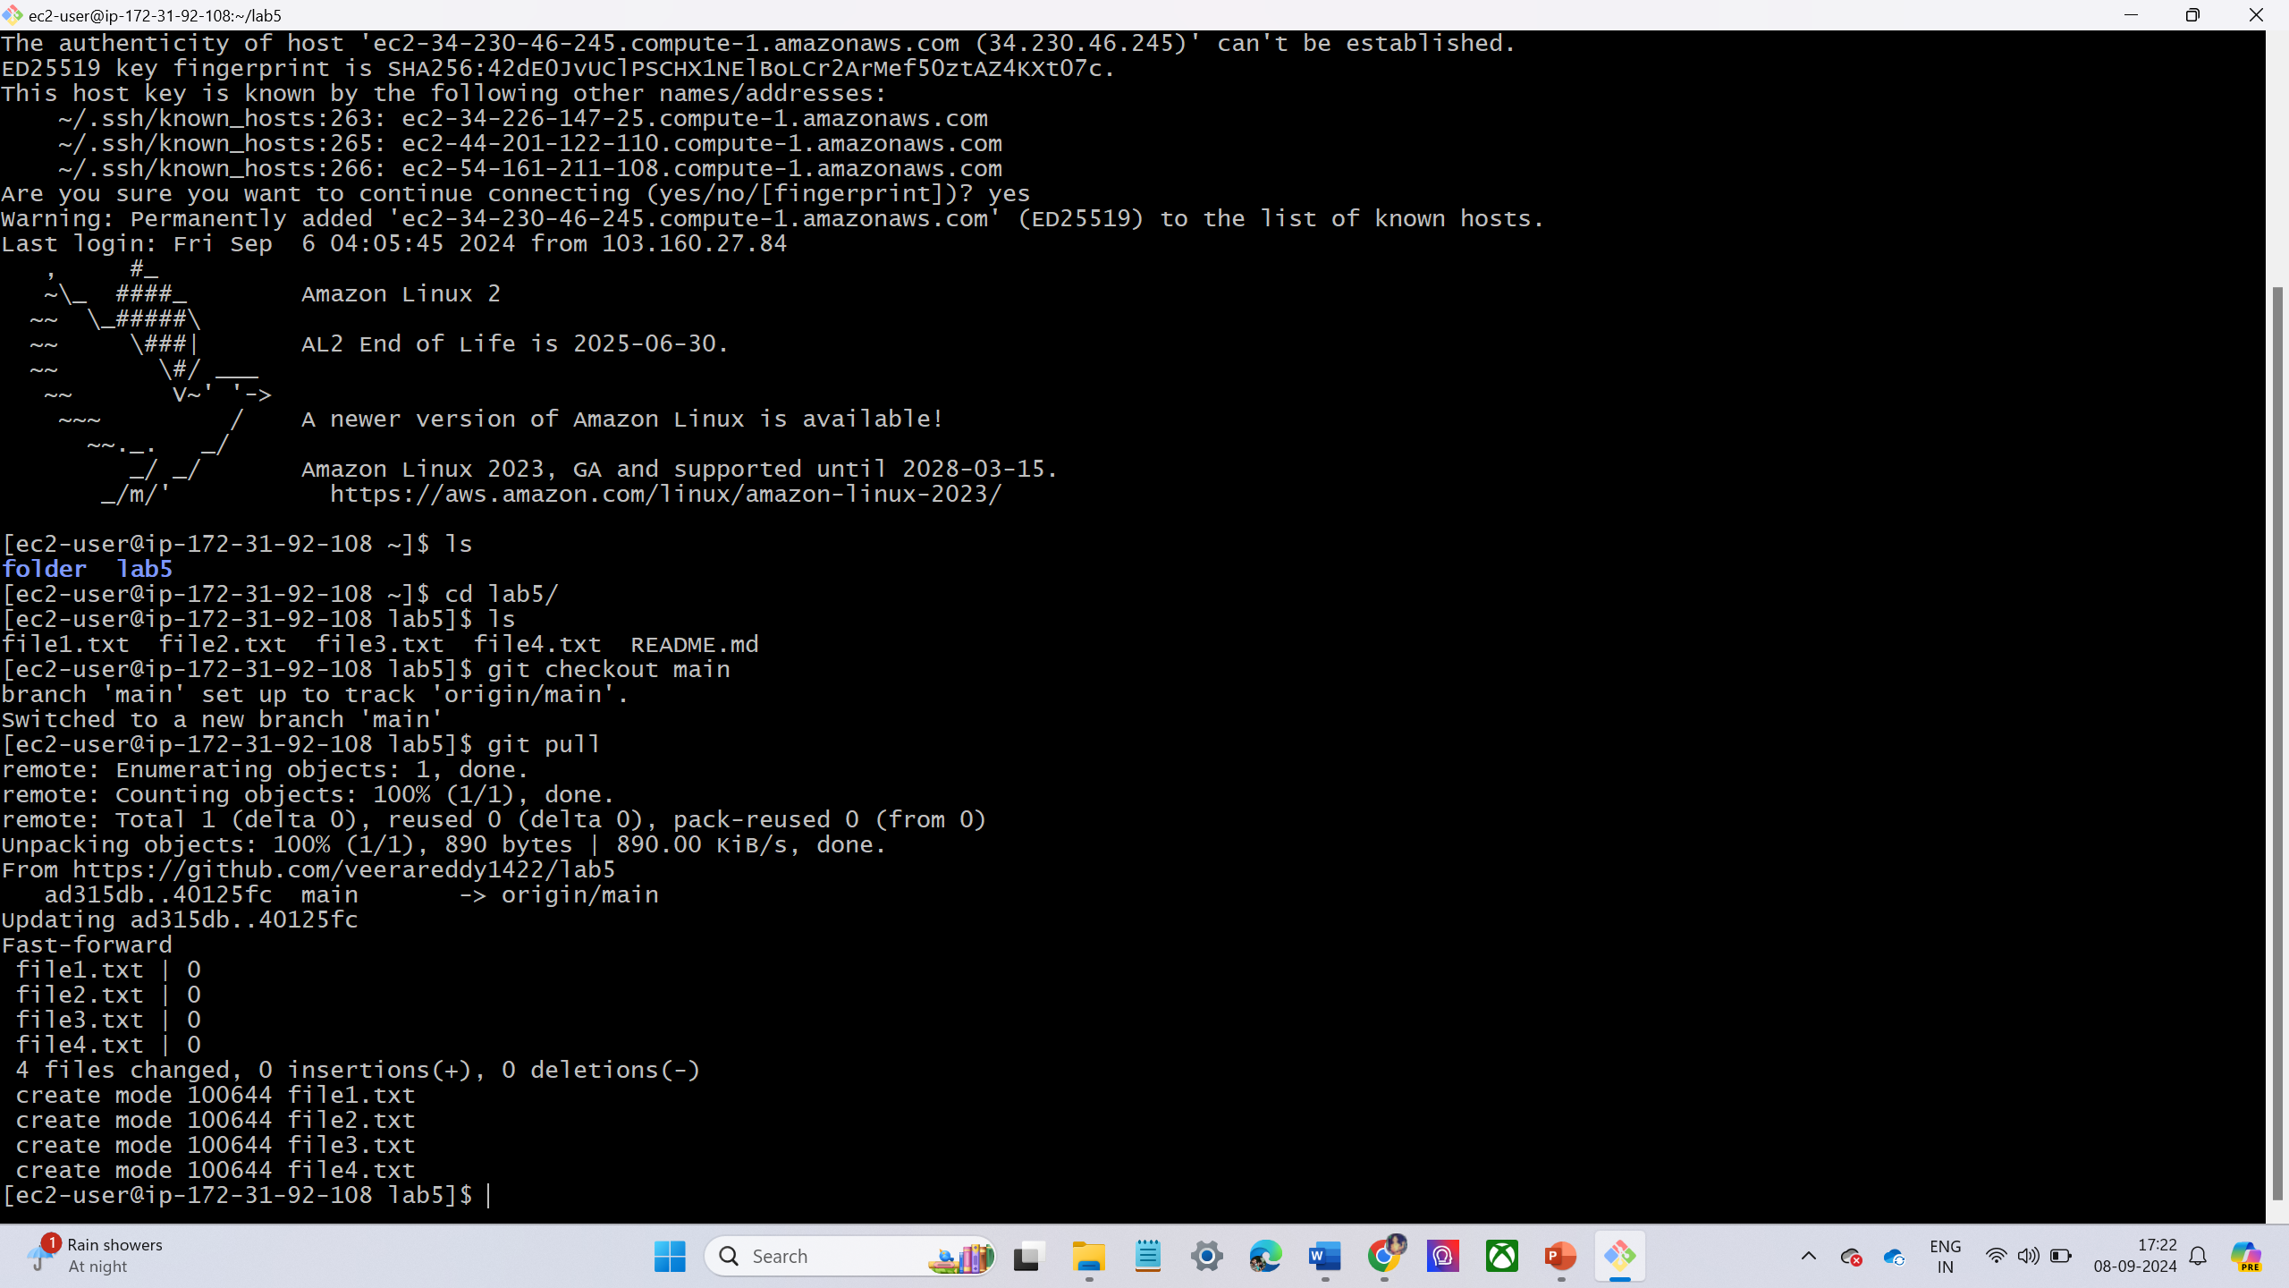
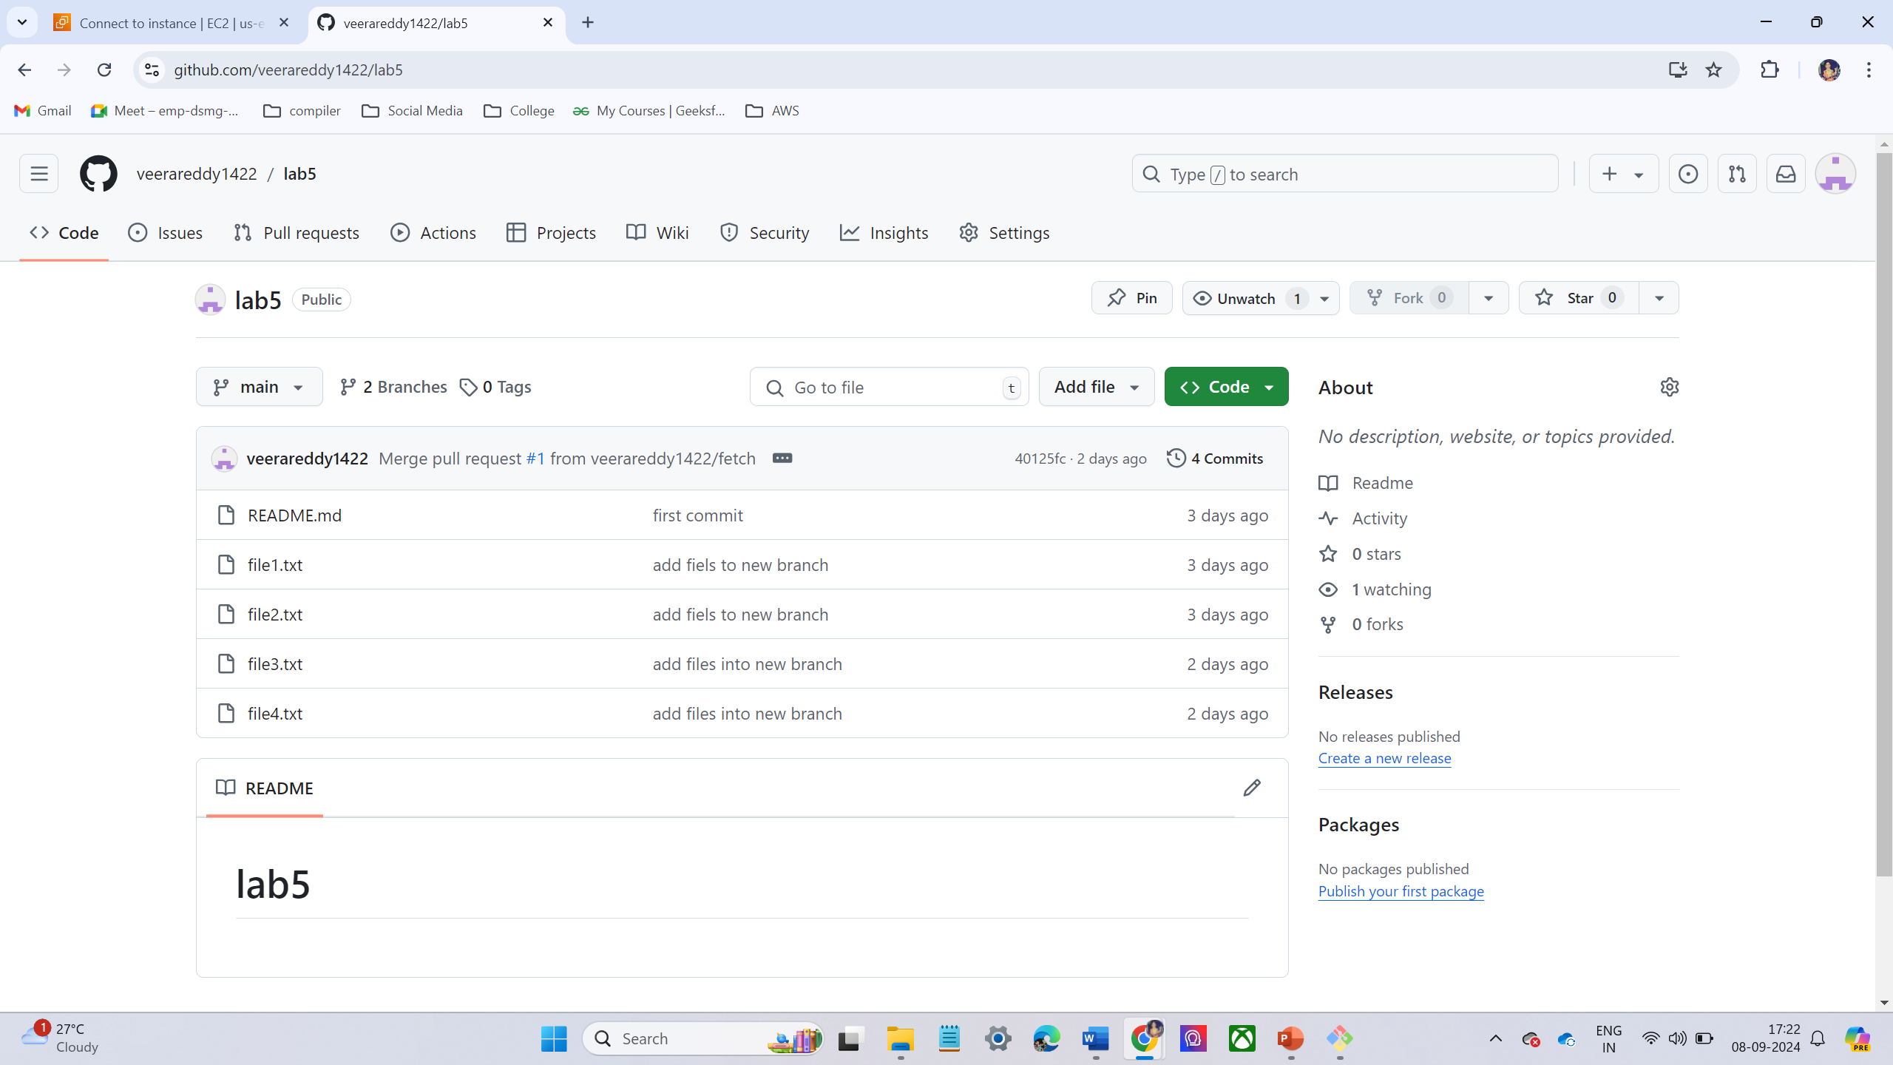
LAB -9 – GOTO LOCAL MACHINE
Goto to local machine
Then go to directory
Now switch to main branch
Pull the latest changes (including branches) from the remote repository using
git pull command.

Slide 22


Slide 23

Any
Questions ?

